Slide 1
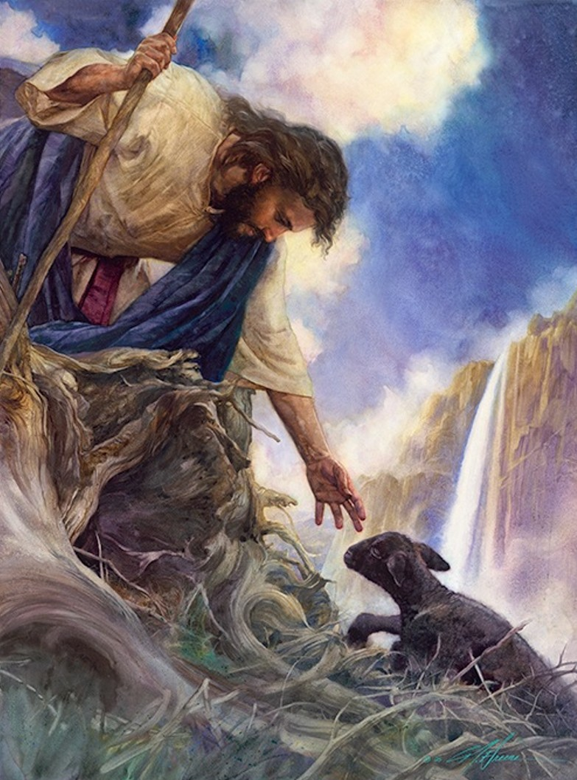
SHEPHERD’S
Manual
Dr. William Charles Breon

Slide 2
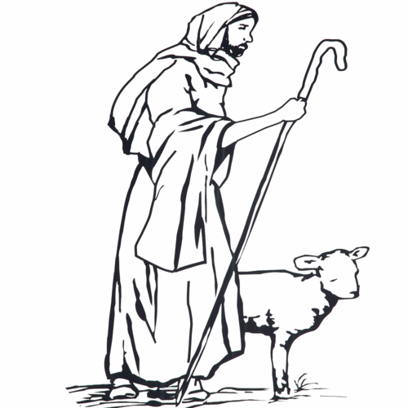
Dedication
To every pastor who longs to please our Lord Jesus Christ!

Slide 3
TABLE OF CONTENTS
INTRODUCTION i
PART ONE: THE CALLING OF THE PASTOR
CHAPTER 1: THE CALL TO PASTOR 1
PART TWO: THE COMPETENCY OF THE PASTOR
CHAPTER 2: RESPONSIBILITIES OF THE PASTOR 15
PART THREE: THE CHARACTER OF THE PASTOR
CHAPTER 3: THE INTEGRITY OF THE PASTOR 79
CHAPTER 4: PERSONAL FELLOWSHIP WITH GOD 86
PART FOUR: THE CHALLENGES OF THE PASTOR
CHAPTER 5: EXTERNAL CHALLENGES 89
CHAPTER 6: INTERNAL CHALLENGES 99
CHAPTER 7: THE 7 CHURCHES JESUS INSPECTED 116
CHAPTER 8: CONCLUSION 120
BIBLIOGRAPHY 121

Slide 4
Introduction
Welcome to the Shepherd’s Manual. I pray that you will be encouraged
and strengthened as you become familiar with this daily resource for pastors.
After serving in ministry for over twenty years and traveling to many churches
around the world, I developed a burden for pastors. I have been privileged to
pastor four different churches during the past twenty years. During this period
of ministry, I have failed at times and succeeded at times. I have made mistakes
and I have accomplished great things as a pastor. Most of all, I continue to
learn. Learning to be an effective pastor is a lifetime pursuit!
The call to being a pastor is very demanding! To be a successful pastor you
will have to dedicate your life to this holy occupation. There is no higher
calling than to faithfully shepherd God’s Church. I applaud your desire to
grow in this calling. As you read through the pages of this manual, open your
heart to the Master Shepherd. Jesus desires to see his flock grow. Jesus loves
his Church and has called under shepherds to serve his divine purposes.
He has called you to take care of His sheep!
i

Slide 5
How to Use This Manual
The Shepherd’s Manual is intended to be a reference guide. Although
you can read it from cover to cover to gain understanding of the material,
the intent of this manual is to provide a guide for daily use.
The Shepherd’s Manual is divided into four sections. Each of these sections
will examine specific issues facing the pastor. They are as follows:
The Call of the Pastor
The Competency of the Pastor
The Character of the Pastor
The Challenges of the Pastor
Use this manual regularly to develop your effectiveness in ministry!
ii

Slide 6
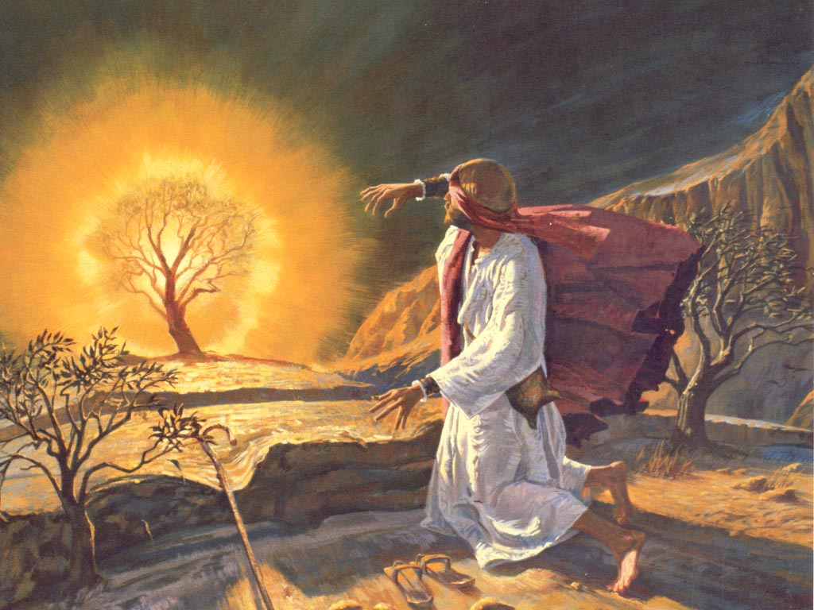
PART ONE:
THE CALL OF THE PASTOR

Slide 7
Chapter One:
The Call of the Pastor
My personal call to ministry was subtle. I did not hear any thunder
claps or see a glowing bush like Moses when I received my call. I
simply responded to the call like the prophet Isaiah responded to his call.
The prophet Isaiah heard the Lord say, “Who will go for us”? When Isaiah
heard the call of God, he simply said, “Here am I, send me”. Many pastors
have entered ministry because they heard the call of God through his Word.
God calls people into ministry in a variety of ways. Moses was called
to deliver Israel from a burning bush, while Gideon put out fleeces to
discern God’s call. The way you are called into ministry does not make
you more important than others. Sometimes ministers embellish their calling
to make themselves seem superior to others. The way we were called is less
important than our response to his call.
Jesus called Peter to take care of his sheep. Jesus repeated his call to
Peter three times. Finally, Peter responded to his master's call. Jesus is
still calling people to feed his sheep. Are you responding to his call?
_____________
1. Isaiah 6
1
1

Slide 8
In my vast missionary travels, I have observed that some pastors develop an ownership
mentality over their church. In many cultures a pastor is esteemed as a village leader.
This sudden promotion into leadership for a typical villager can be intoxicating!
This new status can influence new pastors to develop a dictator attitude over their church.
The result of this ungodly attitude is always negative. If a pastor determines to
own the Church, the spiritual headship of Jesus is removed. When a pastor
replaces Jesus Christ as the spiritual head, the Church no longer functions as the
bride of Christ.
This ungodly shift causes the pastor to see himself as the CEO over a business,
instead of a servant who is devoted to care for people. This kind of pastor
begins to see people as dollars used to support his lifestyle. When a pastor
replaces Jesus as the head of the Church, the pastor views their church as a career
and personal prosperity is the goal.
The Church was purchased with the blood of Jesus Christ. The Church will
rule and reign with Jesus Christ throughout eternity! The glorious Church is not
the property of any man. Pastors are called to serve the Church!
_____________________
2. Ephesians 5:23
3. Acts 20:28 2
2
3

Slide 9
If you have been called to serve a local church, you will be able to endure the ups
and downs of ministry. If you really know that God called you into ministry,
you will be able to stay the course.
However, if you are uncertain about your call to ministry, you will not have the
confidence to stay during difficult times. Thousands of pastors leave the
ministry every year in America. I knew a pastor that became very
discouraged and left the ministry. When I talked with him about his
decision to quit, he said, “I didn’t sign up for this”. He did not have
the confidence that God called him to serve, so in a difficult time he quit!
If you serve without knowing that God actually called, you into ministry
then your obligation to stay is self satisfaction instead of godly obedience.
Because I absolutely know that God called me to serve as a pastor, I can
continue to serve even in difficult times. The reason is simple but profound!
My service is based on obedience to God not personal satisfaction. If you
entered ministry just to make money or because you wanted to do something
good you will struggle during difficult times. Jesus talked about the importance
of being called into ministry. He loves his flock more than anything! He calls
shepherds to take care of his Church! Are you called into ministry?
3

Slide 10
Jesus taught his disciples that a “hired” pastor cares very little for the Church.
The career minded, self serving minister will leave the Church when it becomes
difficult, but the true shepherd will lay down his life for the sheep. Why would
the Shepherd give his life for the Church? The answer is simple, the Shepherd
loves! The call of the local pastor is to love the people of God, just like Jesus!
The call of the shepherd is to take care of Jesus most prized possession!
Think about that for a moment. The most prized possession of the Lord is
the Church. He purchased the Church with his own blood. After Jesus
resurrected from the grave he told Peter to take care of his sheep. The call to
Peter was to love and feed the Church! The Lord never intended that Peter
should become a king ruling over his flock. Pastors do not own the Church,
they serve it! Now imagine the Lord asking you about how you have treated
his Church. How will you respond to Jesus? Are you a king or a servant?
_____________________
4. John 10:11-13
5. John 21:15-21 4
“I am the good shepherd. The good shepherd lays down his life for the sheep. The hired hand is not the shepherd and does not own the sheep. So, when he sees the wolf coming, he abandons the sheep and runs away. Then the wolf attacks the flock and scatters it. ¹³ The man runs away because he is a hired hand and cares nothing for the sheep.
4
5

Slide 11
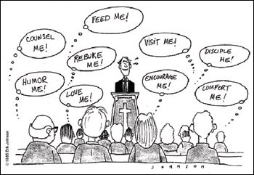
PART TWO:
THE COMPETENCY OF THE PASTOR

Slide 12
Chapter Two:
The Responsibilities of the Pastor
I responded to the Call of ministry twenty years ago. At that time, I was a
successful businessman working for General Motors Acceptance Corporation
as a marketing representative. I enjoyed financial success with General Motors
and looked forward to a promising career.
A large mega church in Virginia Beach, Virginia called me to serve as a full
time pastor. I will never forget ending a promising career to enter into the great
unknown of vocational ministry. My wife and I stepped out of our comfort
zone and said “YES” to the call. This transition required great faith. We would
not have made the move from financial success to financial uncertainty without
a clear call from the Lord.
I still remember my first day at church. I walked aimlessly around the church
facility trying to find something to do! I had no idea what a pastor did during the day!
I thought the pastor only worked on Sunday! I was absolutely ignorant of the
ministry responsibilities of a pastor. Slowly, over time, I began to learn what a
pastor was supposed to do! Now twenty years later I am continuing to grow in my
understanding of what it means to be a good shepherd!
5

Slide 13
I discovered many responsibilities over the past twenty years of ministry
that have challenged me to grow. I continue to recognize my need to develop
competency in many areas of ministry! Here are some of the responsibilities
that I have discovered over the past twenty years of pastoral ministry:
1. Ordinances/Sacraments
2. Weddings
3. Funerals
4. Preaching
5. Prayer
6. Evangelism
7. Leading with Vision
8. Visitation
9. Financial Stewardship
10. Church Government
11. Counseling
12. Protecting the Church
These responsibilities are very important in ministry. Pastors will typically excel in
some of these responsibilities but may be weak in others. Every pastor will have
to focus on developing all these areas to become an effective pastor.
6

Slide 14
You may feel overwhelmed looking at this large list of responsibilities.
Although there is a great amount of information to learn, don’t get anxious
about learning all of these responsibilities all at once! You have time to grow
in each of these areas. The best way to begin ministry is to reach out to people.
If you truly love people, they will forgive your inexperience. The key to growth
is honesty. I would like to think that I am an incredible pastor, but the truth is,
I am very average in many areas. I continue to struggle with some of my
responsibilities even after twenty years of ministry! Sometimes I react to
someone else doing a better job in one of these areas of ministry and feel like a
failure when I compare myself to others. Comparison is very dangerous.
Do not fall into the comparison trap! If you fall into the comparison trap you
will become overly sensitive and you will become very insecure. Overly sensitive
leaders usually develop offenses. If you become overly concerned about what people
think of you, then you will become a man pleaser instead of a righteous shepherd.
Remember, every pastor has both strengths and weaknesses! The key to growth
is to admit that we have weakness! How can we grow if we think we are perfect in
every area? Be honest with yourself! John Maxwell, an internationally recognized
author and trainer says, “The difference between average people and achieving
people is their response to failure”! I continue to make mistakes, so will you.
Remember, our response to failure will determine our future. Come and grow with me!
_______________________
6. Failing Forward by John C. Maxwell
6
7

Slide 15
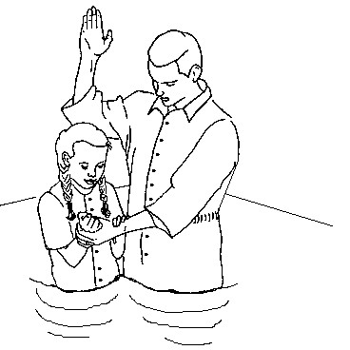
1. Ordinances of the Church
The pastor is responsible to perform the two major ordinances of the Church.
The ordinances of Baptism and Communion are vital to the health of every local
church. I have visited hundreds of pastors around the world and have on many
occasions found that these two ordinances were not operating in their churches.
As the shepherd of a local church, you will need to develop the skills necessary
for effectively conducting these ordinances.
Baptism
For over two thousand years water baptism has been the visible declaration of
personal salvation. The public baptism ceremony is a witness to the world that
Jesus is alive! Water baptism is an exciting event that builds unity in the church
and is a powerful witness to the local community.
____________________________________
7. Matthew 3:13-17, Matthew 28:18-20, Acts 2:38-39, Ephesians 4:5
8. 1 Corinthians 11:23-26, Mark 14:22-25, Acts 20:7
8
7
8

Slide 16
Baptism Event Checklist
Teach candidates about water baptism (Bible study before the service)
Invite the community to this service (flyers or personal invitation)
Plan where you are to conduct the service (lake, river, church)
Gather everyone to the event (a specific time and location)
Share the gospel during this ceremony
Have candidates give a brief personal testimony (while in the water)
Pray for each candidate before you baptize them
Baptize the candidates one at a time after their testimony
Close in prayer and bless everyone present
Invite everyone to a reception with food after the service
A successful water baptism service will touch many people with the gospel.
Take time to plan the service. Invite the community to this event. Make sure
that the candidates have towels and appropriate dress for the event.
Sample Baptism Service
Welcome The pastor welcomes the community while standing in the water.
Explanation The pastor joyfully shares a brief biblical explanation for the baptism ceremony.
Praise A song of praise sung by those in attendance.
Baptism The pastor invites the baptism candidates into the water. The pastor asks each candidate for a confession of faith. After the candidate's profession of faith, the pastor baptizes them by immersion.
Benediction The pastor closes with a prayer blessing!
9

Slide 17
Communion
The Lord’s Supper is a special time of reflection focusing on the crucifixion
of Jesus Christ. The Lord told his disciples to continue the Passover supper!
This service will unite your church around the cross causing personal reflection
and repentance. Some churches practice the Lord’s Supper weekly, while others
practice it monthly. You can determine how often you will practice communion.
You will need to obtain communion elements before the service. Typically,
grape juice is used for the cup representing his blood shed for our sins. If you
can not find grape juice, a different dark colored juice will be appropriate.
The bread served at communion should be unleavened bread as described in
the scriptures. However, if you can not get unleavened bread for the ceremony,
you can substitute the unleavened bread with available bread. The communion
celebration should be approached with introspection and confession of any known
sin.
____________________________
9. Deuteronomy 16:3, 1 Corinthians 5:8
10. 1 Corinthians 11:23-29
10
9
10

Slide 18
Communion Checklist
Ask other pastors how they celebrate communion
Teach the congregation about the significance of communion
Plan for a consistent time to celebrate communion (weekly, monthly)
Recruit helpers to prepare for the communion (bread and grape juice) Plan for a time of worship before receiving the elements
Practice officiating the service - serving bread first and juice last
Sample Service
Welcome
Invocation (Opening prayer)
Worship (Songs focusing on the Cross)
Scripture Reading (1 Corinthians 11:23-29)
Personal Testimonies
Brief Sermon
Pray over the Bread (Representing His broken body)
Distribute the Bread to the congregation
Pray over the Juice (Representing His shed blood)
Distribute the Juice to the congregation
Closing song of praise
Benediction (Closing Prayer)
11

Slide 19
2. Weddings
Weddings are one of life’s greatest celebrations! Conducting a beautiful and
successful wedding requires a great deal of planning. While it is the couples
wedding, your role as officiating pastor can not be underestimated. You will set
the tone for the wedding. Weddings are also an opportunity to gather people
into the church that normally do not attend. Jesus loved weddings and performed
his first miracle at a wedding! The presence of Christ embraces weddings!
Wedding Checklist
Premarital counseling with the couple 6 months before ceremony
Marriage license and other legal requirements
Schedule the time and location of the wedding ceremony
Schedule the time and location of the wedding rehearsal
Plan the Wedding ceremony with the couple
Gather the names of the entire wedding party
Wedding rings and other gifts
Contact musicians, wedding planner, special guests
Finalize wedding location set up
Plan for your role in officiating the wedding
Execute the marriage license and send it to the authorities
12

Slide 20
Sample Service
Prelude Music playing while guests are seated
Entrance of the Bridal Party Pastor and Groom entrance
Brides' maids' entrance
Entrance of the Bride with her father
Welcome Pastor greets the congregation
Invocation Opening prayer by the Pastor
Intent to Marry Opening remarks by the Pastor
Giving of the Bride Pastor asks, “Who gives this woman to
be married to this man”.
Scripture Reading Selected scripture
Special Music Instrumental or voice solo
Pastors Encouragement Briefly encourage the couple about
their new life together and their dependence on God
Vows Have the couple repeat after you
Ring Exchange The best man usually keeps the rings
Prayer Blessing This is a pastoral blessing over the couple
Declaration of Marriage Pastor pronounces them “Man & Wife! “You may kiss the bride”!
Introduce them as Mr. and Mrs.
Benediction Closing prayer
13
This is a sample wedding ceremony; you can modify it to accommodate your culture

Slide 21
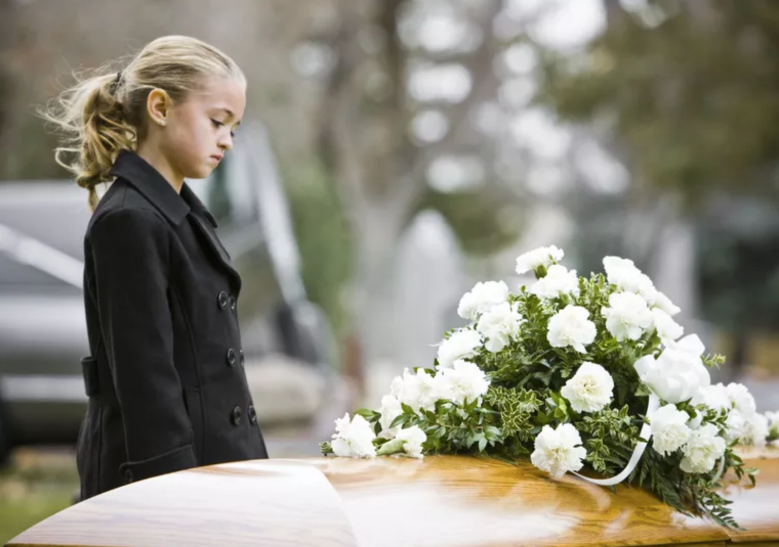
3. Funerals
Funeral ceremonies may be one of the most challenging responsibilities that
you will face as a pastor. Each funeral will be unique. A funeral for a Christian
is far different than a funeral for an unbeliever. A funeral for a young child is
more difficult than a funeral for an eighty-year-old who has lived their full life. Your
presence with the family during this time of loss is very important. You represent
the Lord and can offer peace and hope through the Holy Spirit to those who grieve.
Funeral Checklist
Pray for the guidance of the Holy Spirit
Visit with the family of the deceased and pray with them
Discover personal attributes about the deceased from the family
Include the family in the preparation of the service
Contact musicians, and others who will participate in the service
Work with the funeral home to finalize details
Meet with the family prior to the funeral service
Officiate the service
Travel to the graveside to conduct the final ceremony
Invite family and friends to a reception after the ceremony
Follow up with the family after the service
14

Slide 22
Sample Service
Viewing The viewing normally precedes the funeral
and can be scheduled for the day before the
service or immediately before the service
Prelude Music playing while guests are seated
Welcome Opening remarks by the Pastor to offer
condolences and hope in Christ
Prayer Thank the Lord for His resurrection hope
and comfort for the family
Scripture Reading Read passages appropriate for the occasion
Words of Tribute Pastor begins this segment citing attributes of the deceased
Family and friends share their memories
Song Congregational Worship
Message Pastors message should be brief and filled with hope and encouragement
Song Congregational Worship
Benediction
Travel to the Graveside Typically the graveside service follows the funeral
15
This is a sample funeral ceremony; you can modify it to accommodate your culture

Slide 23
4. Preaching
Preaching the Word of God is an incredible responsibility! The health of
the Church is dependent upon solid biblical preaching. We know that faith
grows through the preaching of his Word. Lives are changed through the
preaching of the Word! Jesus preached the Word with power. That kind
of power is available to pastors today and it is available to you!
There are many different styles of preaching and many different kinds of
sermons. Some pastors have a quiet personality, while others have a sparkling
personality. The Lord can use both kinds of personalities!
Learning to preach is one of the greatest challenges in ministry. Preaching
is not just standing behind the pulpit and shouting for thirty minutes. In my
missionary travels I have observed many pastors as they preached the Word.
On many occasions I noticed the tendency of pastors to shout their hollow
sermons. They yelled at their congregations in an attempt to keep them
awake, while neglecting the depth of the Word that only comes through
serious study. Spending time in personal Bible study will help you develop
an interesting sermon that will feed your congregation and keep them awake!
_________________
11. Romans 10:17
12. Timothy 2:15
16
11
12

Slide 24
The apostle Paul instructed young Timothy, an emerging new pastor, to preach with
preparation! Some pastors believe that sermons should be birthed spontaneously as they
are preaching. Although there is a place for spontaneous preaching, a lack of preparation
usually produces shallow sermons. Preparation is hard work!
The Lord wants his shepherds to be fully prepared to deliver the Word to his flock on
Sunday. The lack of preparation in the ministry of the Word will eventually weaken the
Church. There are four major steps to the preparation of a sermon!
Each one of these steps in sermon preparation are vital for developing a good sermon.
Before I stand in the pulpit to deliver a sermon, I want to sense the big idea for the sermon.
I always begin my sermon preparation with prayer and reflection. I also listen to the concerns
of the congregation and I observe the needs of the church. Isn't that what a shepherd is
supposed to do with his flock? I pray about the big idea all week until I find it. I do not want
to stand behind the pulpit and preach someone else's sermon. The Word must be alive and
fresh in the pastor’s soul or it will be stale and boring to the congregation.
__________________
13. 2 Timothy 4:2 17
13
“Preach the word; be prepared in season and out of season”
1. The sermon idea
2. The sermon research
3. The sermon formation
4. The sermon delivery

Slide 25
As I spend time with the congregation, I often sense a specific theme that
the church is dealing with in their personal lives. Perhaps the economy is
poor and many in the fellowship are struggling financially. This need may birth
the sermon idea. As you pray for the congregation, the Lord may inspire you to
preach on faith. Very often the “big idea” forms the sermon title. Let's say that
you want to encourage your church by preaching about faith. The sermon title
could be, “His eye is on the Sparrow”. This sermon title introduces the fact that
God loves all of his creation and takes care of it! This wonderful fact includes
us! If he loves the sparrow and watches over it, then he certainly loves us!
The next step in sermon preparation is sermon research. Now that you
sense the Lord leading you to preach about faith, you will need to research faith.
What is faith? What does the Bible say about faith? What does the Greek word
for faith mean? As you research faith, you can also research for illustrations
that will help you communicate the big idea. What illustrations, stories or
personal testimonies will help demonstrate faith to your congregation? Now
that you gathered all your information and illustrations for the sermon, you
can begin the third step of sermon preparation which is sermon formation.
18

Slide 26
Sermon formation is how you organize the sermon. This step usually takes
around thirty minutes to complete. Although it does not take a great amount of
time, it does take considerable creativity. Here is an example of sermon formation:
Sample Sermon
Title: His Eye is on the Sparrow
Big Idea: If God watches over little sparrows, surely, He watches over us! This truth will build faith!
Introduction Hold up a sparrow in a cage and share how God
sees this little bird- amazing! He also sees us!
Scripture Reading “Look at the birds. They don't plant or harvest or store food in barns, for your heavenly Father feeds them. And aren't you far more valuable to him than they are” Matthew 6:26
1. God of the Sparrow This point develops the truth that God cares for
all of his creation. If God knows every sparrow
in the world, then surely, he knows our needs.
2. God of my Needs This point develops personal faith in believers. Use illustrations and stories about how faith
works. Ask this question: Do we believe that God
desires to take care of us? Or are we consumed with doubt and fear?
Conclusion How do we respond to his promise that he will take care of us? What is the condition of our faith?
Prayer and Altar Call Invite people to come forward for personal prayer.
19

Slide 27
Building a sermon is like building a house. The foundation of the house is the big idea.
The entire sermon stands on the foundation. The walls of the house are the main points
of the sermon. The walls hold the house together. Some sermons may have two major
points while other sermons may have three or more points. The front door is the
introduction to the sermon. The introduction should be appealing. Most people will
give the pastor three to five minutes to gain their attention. If the door is not inviting,
then your guests will not enter your house. Windows are illustrations that let light into
the room. Illustrations bring perspective to the sermon. A good sermon will have these
major components. The sermon formation step must include the floor (big idea), walls
(sermon points), a front door (introduction) and windows (illustrations).
The final step in forming a sermon is deciding on the ending. What do you want to
accomplish with this sermon? What is the intent of your sermon? Different sermons
typically have different endings. For example, an evangelistic sermon should end with
an invitation to receive Jesus Christ as savior. If you preach a sermon on fear the
ending could include personal ministry for those struggling with fear.
20
The Walls
Main Points of the Sermon
The Front Door
The Introduction
The Windows
Sermon Illustrations
The Floor
The Big Idea
20

Slide 28
The final step for preparing a good sermon is the sermon presentation. Pray
about the sermon and ask the Holy Spirit to direct you as you get ready to
present the sermon. Invite your elders or deacons to join you thirty minutes
before the service to pray over the service and to pray for you. Preach according
to the theme of the intended message. Do not shout this sermon on “His Eye is
on the Sparrow”. Instead, you should be sympathetic to those who are suffering
and need the assurance that God sees them and loves them.
It is ok to be slow, and sensitive during this kind of sermon. At other times
you may need to shout and use vivid gestures to illustrate a different type of
sermon. For example, a sermon on revival should not be preached in a monotone
or lifeless manner. The key to effective preaching is to preach in a manner that
faithfully communicates the message that God gave you to preach! A good
preacher will be flexible and sensitive to the moment, understanding that
different sermons will require a different delivery! Work on your delivery!
Look in the mirror and watch yourself preach! Do you have good gestures? Do
you look relaxed and natural? Do you have a good posture? Are you well
groomed? Do you have good voice inflection? Do you speak clearly? Watch
other speakers and study their sermon delivery! Continually work on your delivery! 21
Your goal is to have people encounter Jesus through the Word.

Slide 29
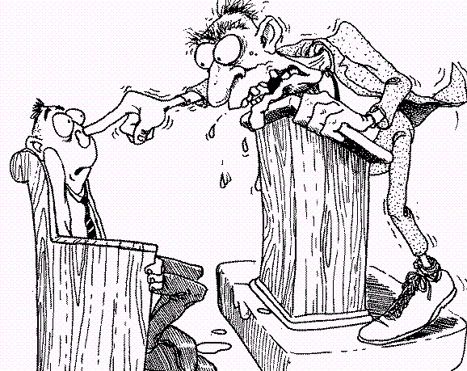
It is very important that you also adjust your delivery to the size of your
congregation. If you have a congregation of ten people, your delivery should
be more personal and natural. You should not shout at ten people during your
entire sermon. Many pastors think that loud preaching is anointed. In reality,
loud preaching to a small group can be annoying!
However, if you are preaching to a large group of one hundred people, you should
adjust your delivery accordingly. If you preach in a monotone lifeless manner you
will not connect with the larger group. I have preached to groups of ten and to
groups of thousands. I have learned to adjust my delivery to meet the needs of
different congregational sizes. Here is a guide for adjusting sermon deliveries:
It will take a lifetime to become an outstanding speaker! Do not give up!
Preaching to small groups Preaching to large groups
Natural gestures
Relaxed and personal
Individual eye contact
Mild voice inflection
Sharing
Vivid gestures
Passionate
Broad eye contact
Strong voice inflection
Declaring
22

Slide 30
5. Prayer
Jesus said, “My house shall be called a house of prayer”. Prayer is often
minimized in ministry because we can rely on our own skills, technology, and routines.
When I first began ministry, I worked hard and prayed little. Eventually I learned
about the necessity of prayer.
The pastor needs to spend time alone with the Lord in prayer. The Lord will meet
with you and give you his heart for the Church. Remember, the busy schedule of
ministry will attempt to minimize your time in prayer. Pastors must be very careful
to guard their time in prayer and to make prayer a priority in their church!
___________________
14. Matthew 21:13
23
14
Dr. A.C. Dickson wrote this about prayer;
“When we depend upon organization, we get what organization can do, and that
is something.
When we depend upon money, we get what money can do, and that
is something.
When we depend upon ministry, we get what ministry can do, and that
is something”.
But then he said, “When we depend upon prayer, we get what God can do and that is everything”.

Slide 31
From the beginning of the Bible to its conclusion, we see absolute evidence
that God answers prayer. Things that we think are impossible, God does when we
come to Him in prayer.
Prayer opened the Red Sea.
Prayer brought manna from heaven.
Prayer made the sun stand still.
Prayer brought fire from heaven.
Prayer defeated superior armies.
Prayer healed all manners of sickness.
Prayer cast out demons.
Prayer provided money and provision.
Prayer protected the innocent.
Prayer revealed the presence of God.
Prayer raised the dead.
Since these historical facts confirm the power of prayer, shouldn’t we bend our
knees and once again invite God into our circumstances through prayer? So, why
don’t we pray if we know that there is power in prayer? Why are prayer services
the least attended ministry event in many churches? Here are a few quotes that help
capture the current sentiment toward prayer:
“The tragedy of our day is not unanswered prayer, but unoffered prayer”
“Most people talk more about their problems that praying for them”
“More is said about prayer and less done than any other subject in the Bible”
24

Slide 32
Prayer Events
The pastor should include prayer in the entire life of the church. Here are some
great ways to include prayer during your church events.
1. Wednesday evening prayer service
2. Special days designated for prayer and fasting
a. New year’s eve prayer meeting
b. Prayer service for the persecuted church
c. Prayer service for the peace of Jerusalem
d. National day of prayer service
3. Prayer for the sick- Have a special time of prayer for the sick
4. Prayer for a new baby- Prayer during baby dedications
5. Prayer for a new home- Prayer blessings over a new home
6. Prayer for missions- Special times of prayer for missionaries
7. Prayer for graduates- Prayer blessing over graduates
8. Prayer for the needs of the saints- Prayer at the altar
9. Prayer for God’s will & wisdom- Prayer in counseling sessions
10. Prayer encouragement- Personal prayer for the discouraged
These are just a few kinds of prayer events led by a pastor in ministry.
25

Slide 33
Prayer Types
When I first started ministry, I only knew of one type of prayer. I prayed petition
prayers for people but did not know how to intercede, pray warfare prayers or
pray prayers of repentance. As I began to serve as a new pastor, I was
exposed to a rich variety of prayer. I was amazed at the anointed prayer offered
by godly saints. Very often I felt inadequate around seasoned intercessors. For
several years I struggled in developing my prayer life until a familiar scripture
revealed the beauty of prayer. One day as I was reading the Lord’s prayer the
Holy Spirit spoke to me and said, “This is not a religious prayer to be mindlessly
repeated, but is instead a model for prayer.” I stopped reading and began to reflect
on what the Holy Spirit said. Then I saw it. The disciples asked Jesus how to pray.
In response Jesus said, this is how you should pray. Jesus responded to the request
for learning how to pray by giving us a model for prayer. The Lord’s prayer
contains several beautiful themes. Each theme has a different prayer focus.
___________________________
15. Matthew 6:9
26
15

Slide 34
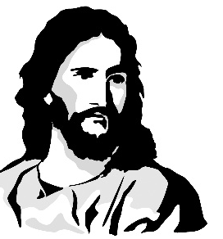
Prayer Themes
in The Lord’s Prayer
“Our Father in heaven” Theme- Praying confessions of thanksgiving to our Father-Intimacy
“Hallowed be your name” Theme- Praying the names of God- Adoration
“Your kingdom come your will be done on earth as it is in heaven.” Theme- Prayer of Dominion
“Give us this day our daily bread.” Theme- Prayer of daily needs
“Forgive us our debts as we also have forgiven our debtors.” Theme- Prayer of Repentance
“And lead us not into temptation but deliver us from the evil one.” Theme- Prayer for Deliverance
“For thine is the kingdom and the power and the glory forever and ever” Theme- Prayer of Praise
The Lord’s prayer is known around the world. Millions of people pray it everyday.
I have quoted it in funeral services and in sermons. Almost every believer knows this
prayer. Before Jesus shared this prayer with his followers, he warned them not to recite
prayer like the pagans who would babble their prayers in ceremonial chants. He was not
teaching them a ritual, instead he was teaching them a model. Jesus said to them, “this is
HOW you should pray, not what you should pray! Many recite the what of this prayer
and miss the HOW of the prayer. I believe Jesus was teaching the disciples HOW to pray.
He revealed specific themes in this beautiful prayer. As you open your heart to the
different themes of the Lord’s prayer, ask the Lord to teach you how to pray!
27

Slide 35
“Our Father”
The Lord begins his teaching about prayer with relationship. Prayer isn’t
supposed to be a religious duty. Prayer is intended to be a personal delight.
Prayer begins with meditation and adoration about Abba Father. Many people
may feel uncomfortable with such intimacy especially when so many people
do not have positive images of their earthly fathers. We live in a fatherless
society. Many children do not know their dads, or have a negative
impression about them. So, starting prayer with “Our Father” may be difficult
for many who have been abused or wounded by their fathers. Jesus did not have
a problem with his earthly father or his heavenly father. He started prayer with
affection and love by calling on daddy. It takes effort to cultivate this kind of
prayer. This prayer is a reflective prayer that focuses on Father God and his
goodness. Jesus was teaching us how to begin our prayer. Our focus is on
Abba and we take time to talk to Him before we move on to the next part of
the Lord’s prayer.
Sample Prayer
“Lord, I love you and thank you for being my Father.
(Stop and wait- listen for His voice)I am grateful for your love, your disciple and your care for me. I want to know you more than anything in life. I am so grateful for you and for all of your many blessings.”
28

Slide 36
“Hallowed be your name”
After we spend some time in reflective prayer giving thanks to our Father, we
transition to the next theme in the Lord’s prayer. This theme helps us learn how
to adore the Lord. We reflect on his goodness by reflecting on his names. Each
name of God reveals more of his amazing attributes. Jesus taught us to hallow
the names of the Lord. What does it mean to hallow?
We need to learn how to revere the Lord’s name! King David revered the Lord’s
great name in his prayers. David loved the name of the Lord and hallowed it.
King David loved the names of the Lord! When we think about his marvelous
attributes we begin to comprehend his greatness. Our image of God expands!
When our understanding of God expands, our faith grows!
To hallow is "to make or set apart as holy. To respect or honor greatly; revere." In simpler terms, we often use hallowed to refer to someone whom we should treat with awe and respect because they deserve it.
“I will exalt you, my God the King; I will praise your name for ever and ever. Every day I will praise you and extol your name for ever and ever. Great is the Lord and most worthy of praise; his greatness no one can fathom”. Psalm 145:1-3
29

Slide 37
The Names of God
ELOHIM……Genesis 1:1, Psalm 19:1 meaning “God”, a reference to God’s power and might. ADONAI……Malachi 1:6 meaning “Lord”, a reference to the Lordship of God. JEHOVAH–YAHWEH…..Genesis 2:4 a reference to God’s divine salvation. JEHOVAH-ROHI……Psalm 23:1 meaning “The Lord my shepherd” JEHOVAH-SHAMMAH…….Ezekiel 48:35 meaning “The Lord who is present” JEHOVAH-RAPHA………Exodus 15:26 meaning “The Lord our healer” JEHOVAH-TSIDKENU……Jeremiah 23:6 meaning “The Lord our righteousness” JEHOVAH-JIREH………Genesis 22:13-14 meaning “The Lord will provide” JEHOVAH-NISSI………Exodus 17:15 meaning “The Lord our banner” JEHOVAH-SHALOM……..Judges 6:24 meaning “The Lord is peace” EL-ROI…………….Genesis 16:13 meaning “The strong one who sees” EL-SHADDAI…………Genesis 17:1,Psalm 91:1 meaning “The God of the mountains or God Almighty”
Sample Prayer
“Lord you are awesome in power and full of glory. Thank you for being my Jehovah-Jireh! You are my provider and I fully trust you. You are my Jehovah
Shalom. You are my peace. I rest in your sovereign care! Thank you for being my hope, my help and my God. I honor you name above all names.”
30

Slide 38
We hallow his name when we give him glory and sanctify his
name. Praying the names of God is awesome. When we hallow the different
names of God we begin to discover his infinite goodness, his matchless splendor
and his mighty power. His name(s) begin to build faith in our hearts as we
transition to the next part of the Lord’s Prayer.
“Your Kingdom Come”
This theme focuses on releasing the kingdom of heaven upon the earth. This
kind of prayer is more declarative and less reflective. We can pray that the kingdom
of God would invade an area or region. Our church mobilized a prayer team to go
and stand outside an abortion clinic for three years. Those intercessors faithfully laid
siege to the property in prayer. After three years of praying for his kingdom to invade
that dark place, the clinic was closed! The property was sold to a ministry. The
kingdom of God invaded that horrible clinic and closed it. There really is power
in prayer! The Lord wants his disciples to learn how to release heaven on earth. This
kind of prayer is bold and humbly calls on heaven to invade dark places.
31
Sample Prayer
“Lord we ask you to invade earth with your kingdom! We pray that the justice of heaven would invade this darkness. We pray that the healing of heaven would touch many lives. Lord we ask for your kingdom to come to earth.”

Slide 39
“Give us this day our daily bread”
The Lord understands our daily needs. He lived on earth and felt the pang of
hunger. He instructs us to ask for our daily needs. When I was a student attending
Appalachian Bible College, I worked at the local A&P food store. One evening
I felt an unusual unction to take some of the left-over deli food to a family. The
store manager allowed us to take the left-over food that would be thrown out the
next morning. So, I took a large amount of food and packed it in my car. I
drove to the family's home and tentatively knocked on their door. What would I
tell them? Would I offend them with this slightly overcooked food? The door
opened and I offered the food to the wife of the college student. She immediately
thanked the Lord and called the children to the door. She motioned to the dinner
table that had been neatly set for dinner without any food. When she received the
food she said to her four children that the Lord had heard her prayers. Tears
began to stream down her face as she thanked me for hearing the Lord. She had
set the table without any food, but prayed and thanked the Lord for her daily
bread. I will never forget that moment. I still remember the Lord speaking to my
heart about the extra food and about the family that needed it. That has never
happened again in my life. I am so grateful that I got to witness her powerful
prayer miracle for daily bread. James teaches us that we have not because we ask
not! Ask God for your daily needs!
32

Slide 40
“Forgive us our debts”
This kind of prayer focuses on repentance. The best example of this kind of
prayer is found in Psalm 51. David had sinned greatly before the Lord and
Israel. He had committed murder, and adultery. This Psalm is a beautiful
example of repentance. A few years ago, I was teaching a small group of
pastors in the Amazon region of Peru. During the conference I felt led to call the
men to repentance. Many of them did not know what to pray. I invited them to
bring their Bibles to the altar and to pray from Psalms 51. As the men read from
Psalm 51 and confessed their sin, sounds of convicted hearts began to ascend to
the throne of God. The men were weeping, wailing and confessing their sins
as they read from Psalm 51. The apostle John encourages us to confess our sin
in 1 John 1:9. He encourages repentance and teaches us that, “He is faithful and
just to forgive our sins, as we confess them”. Sadly, many believers never engage
in this kind of prayer. They believe that after salvation they no longer need to ask for
forgiveness when they sin. The apostle John wrote to the church to remind them that
they needed to confess their sin. When this happens revival can overtake a region.
Many revivals focus on this kind of prayer. I visited the Brownsville revival in
Pensacola, Florida. The Spirit of God moved on multitudes. The common theme
was repentance.
33

Slide 41
“Lead us not into temptation but deliver us from evil”
This kind of prayer focuses on spiritual warfare. When I was in Africa, an
evangelist named Frank Oasis prayed a prayer of deliverance over a man. I will
never forget the experience. The man receiving the prayer of deliverance began
to writhe like a snake on the ground. He looked like a serpent. After some intense
prayer the man came into his right mind and straightened out. Something amazing
had happened. He was set free from evil. Jesus gave us authority over demons!
He gave us authority to pray for those bound by demons to set them free. This
kind of prayer is not timid or reflective. When I was in the Amazon on one of my
earlier trips, a doctor brought a man over to me for prayer. He was moving like a
snake. I remembered my earlier experience in Africa, so I began to pray for him.
After a few moments, the doctor brought me back to the same man. The man had
continued moving like a snake after my prayer. The doctor smiled at me and said,
“The first prayer didn’t work, try it again”. I took a deep breath and realized that
I hadn’t prayed with the authority of Jesus. This time I prayed with bold faith
and commanded the demon to go, in the name of Jesus. After a few minutes the
doctor came back and said, “great job, it worked this time”. We both laughed.
What was the difference between the two prayers? The second prayer was offered
in faith and boldness. Different kinds of prayers require different kinds of emphasis.
34

Slide 42
“For Thine is the glory”
This kind of prayer focuses on absolute surrender in praise. While I was visiting
Kansas City attending an International House of Prayer (IHOP) conference, I
experienced an unusual manifestation of his glory. The International House of
Prayer located in Kansas City focuses on 24/7 night and day prayer. During one
of the conference sessions, there was a mighty release of prayer and praise. As
we lifted up our hearts in absolute worship the atmosphere was filled with his
glory. I have never been “slain in the spirit”, but on this occasion, I came close.
While we were giving glorious praise to the Lord, my knees buckled and
something happened to my body. The glory of the Lord pressed me. I looked
around the room and saw many people laying on the floor. I was holding on to
the chair with weak knees and eventually had to sit down.
The glory of the Lord had descended on us. This was the only time that I had
ever experienced anything like that. The only thing I can say is, I want more!
All glory belongs to Him. This prayer focuses on giving God complete
heartfelt praise! Allow yourself to be totally abandoned to God in absolute worship.
Prayer and praise mix together when you become consumed in his presence!
35

Slide 43
Different Kinds of Prayer
The great Apostle Paul wrote this about the necessity of praying different
kinds of prayer to the Ephesian believers. He said, “Pray in the Spirit on all
occasions with all kinds of prayers and requests.” Paul instructed the
believers to pray with all kinds of prayers. This confirms that there are
many different types of prayers.
I hope you are inspired to take a closer look at the themes of the Lord's prayer!
Take time to study them. There is power in prayer!
Different situations will require different types of prayer! Here are some
examples of using different types of prayer for different occasions”.
1. Prayer for the sick- Intercession prayer
2. Prayer for victory- Dominion prayer
3. Prayer for provision- Petition prayer
The pastor is responsible to learn the different kinds of prayer and is responsible
to teach the congregation how to pray. The Lord’s Prayer teaches us how to
pray! Take time to pray the different themes of the Lord’s prayer!
36

Slide 44
Sample Prayer Service
Welcome Spend time in open discussion with the congregation listening for prayer needs and asking for prayer
requests- this is informal and relational!
Worship Worship the Lord and listen to the Holy Spirit!
Opening Prayer Give thanks and praise for God’s goodness!
Group Prayer The pastor helps guide group prayer toward
different themes!
Pray the different kinds of prayer during the
meeting.
Enter into His gates with thanksgiving and praise.
Thank the Lord for his goodness. He is a good dad.
Honor the names of God.
Pray repentance prayers focusing on confession of sin.
Prayer for revival.
Petition prayer for congregational needs. Pray for
provision, healing, and other needs.
Give God glory!
Body Ministry Minister to individual needs as they come up!
Benediction Testimonies and closing prayer!
37

Slide 45
Fasting
“Fasting and prayer are one of the most powerful spiritual combinations
on earth. True fasting brings humility and alignment with God. It breaks the
power of flesh and demons. It kills unbelief and brings answers to prayer
when nothing else works. It has been well said that prayer is not preparation
for the battle – prayer is the battle. And of all the things we can do to
enhance the power and focus of prayer, fasting is doubtless the most potent”.
Jesus fasted, Daniel fasted, Moses fasted, Elijah fasted and the early church
spent a great amount of time in prayer and fasting.
The pastor needs to encourage the church to fast when they pray!
_______________________
16. Christian-faith.com
16
“And when they had appointed elders for them in every church, with prayer and fasting they committed them to the Lord in whom they had believed”. Acts 14:23
“Yet even now,” declares the Lord, “return to me with all your heart, with fasting, with weeping, and with mourning;” Joel 2:12
“Now there were in the church at Antioch prophets and teachers, Barnabas, Simeon who was called Niger, Lucius of Cyrene, Manaen a member of the court of Herod the tetrarch, and Saul. While they were worshiping the Lord and fasting, the Holy Spirit said, “Set apart for me Barnabas and Saul for the work to which I have called them.” Then after fasting and praying they laid their hands on them and sent them off”. Acts 13:1-3
38

Slide 46
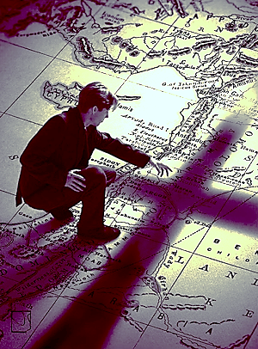
6. Evangelism
The prime directive of the Church is to GO!
Jesus gave the Church her marching orders before he ascended to his Father.
Jesus told the apostles to “GO” into all the world to preach the gospel! Paul encouraged
young Timothy to include the work of an evangelist in his pastoral duties. Many times
a pastor will get consumed with the demands of church ministry and neglect outreach to
their community!
The Church exists to proclaim the gospel of Jesus! God is not willing that any should
perish, but that all should come to repentance! A beautiful church facility is not the
measure of success in the kingdom of God. Success in ministry relates to souls being
won for Jesus Christ!
________________________
16. Matthew 28:16-20
17. 2 Timothy 4:5
18. 2 Peter 3:9
16
17
39

Slide 47
There are many ways that a local church can impact its community with the
gospel of Jesus Christ. Here are a few examples:
Outreach Examples
1. Visitation- Go door to door to share the gospel- go with some volunteers!
2. Special Services- Invite the community into the Church for special services.
3. Outreach Ministries- Develop special ministries to encourage your local
community. Vacation Bible School for kids, food pantry for the needy, job
training, sports events, radio broadcasts, health training and other ideas
that will bless your community. Your church can be salt and light!
4. Missions Teams- Develop cross cultural missions teams to go to other
places both at home and to foreign locations!
5. Plant a Church- Your congregation can plant a new church! New churches
planted in new communities create excitement and expand the kingdom!
6. Children’s Ministry- This is an incredible way to introduce Jesus
to families in your community!
Your local community is unique. Your church has the ability to reach your unique
community better than most other churches! Why? Because you understand the
history, the culture and the language of your community!
One of the best ways to share the gospel with your community is to develop a vibrant
children’s ministry!
40

Slide 48
Church statistics reveal that 83% of the people that come to Jesus Christ
do so before the age of fourteen. Jesus said, “let the little children come to
me”! Jesus knew that children would receive his call to salvation. He also knew
that adults would see little value in reaching out to children.
As I travel around the world, I often observe that children are considered to
be a nuisance. Church services are usually filled with children that distract their
parents' attention from the sermon because they are bored. One of the churches
in the Amazon region of Peru struggled with this problem. Parents would
harshly correct their bored children during the service, causing a dislike for the
church in both their children and in themselves. Was there a solution? Yes!
Children's ministry solved this unpleasant situation. We taught church members
how to minister to children and then dismissed them after the praise service to go
to children’s church before the sermon. The results were staggering. The children
loved church and began to invite other children to their fun service. New children
brought new parents. Many came to salvation and the church grew by focusing on
children. Jesus said, “let the little children come to me”! Invite children to a
fun interactive service and they will invite other friends to the church. You can
impact your community through children’s ministry.
________________________
19. International Bible Society Survey
20. Matthew 19:14
19
20
41

Slide 49
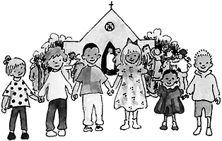
Sample Children’s Church
Welcome Gathering the children for the service.
Games Playing fun games with the children!
Refreshments Cooling down and enjoying some juice and cookies.
Praise Sing youth-oriented songs!
Bible Story Children love stories. Teach the Bible the way Jesus did by using stories!
Application Children will open their hearts to the gospel. They can trust God and respond to the gospel at a young age. Pray
for the children. Many will give their hearts to the Lord.
I was saved at the age of 13!
Developing an effective children’s ministry takes time. The key to creating a great
children’s ministry is to find the right person to help you. This should be a person who
loves children and will be faithful in their service. You will need to partner with this
ministry leader. Allow them to be creative. Do not micromanage them.
Spend time with the children’s ministry leader and dream together.
42

Slide 50
The Lord is not willing that any should perish! His heart is for all humanity.
The Lord wants his Church to be salt and light in their local community!
The local church represents his love and his kingdom to a lost world. The
Church is commanded to share the gospel of Jesus Christ with the world.
“The Lord is not slow about his promise, as some people understand slowness, but is being patient with you. He does not want anyone to perish but wants everyone to repent.”
2 Peter 3:9
The central truth of the gospel is that God has provided a way of salvation
for men through the gift of his son to the world. Jesus suffered as a sacrifice
for sin, overcame death, and now offers a free gift of salvation to all who will
accept it. The gospel is good news because it is a gift of God, not something
that must be earned by penance or by self-improvement.
In 1 Corinthians 15:1-8, the apostle Paul summarizes the most basic
ingredients of the gospel message, namely, the death, burial, and resurrection,
of Jesus Christ. This is the message of the Church! This is the hope of the world!
The pastor is responsible to share the gospel of Jesus Christ with a lost and dying
world!
43

Slide 51
7. Leading with Vision
When I first began to minister as a new pastor, I spent a great amount of time
attempting to learn my new responsibilities. I focused on learning how to
develop sermons, and how to officiate weddings, funerals and other special
services. Although I was growing and felt good about my progress, I will never
forget the day that a church friend came to me and told me that they were going to
leave the church. Their statement hit me like a nuclear bomb. I cared for this
family and did not want to see them leave the church. So, I made an appointment
to hear their heart. I later labeled this kind of meeting as an exit interview.
I recommend that you meet with people who leave your church. This will
provide feedback to you on how to improve your ministry. As I listened to this
church member I realized that I had an undeveloped area in my ministry.
The complaint of the person leaving was simple, he said that I did not lead with
vision. He stated that he loved me and appreciated me, but that I did not lead!
This feedback hurt me deeply and I wanted to quit ministry after I heard his
comments. When you get hurt in ministry, and you will, do not allow your emotions
to control you. Take time to recover and remember your calling.
44

Slide 52
Over the years I have struggled to develop visionary leadership. The Bible
teaches us that “without vision, people will perish”. People come to Church for
different reasons. Some come to Church to serve, some come to Church to grow
while others come to Church to find vision. A pastor once told me an illustration
about the need for visionary leadership. He said, “ if there is mist in the pulpit,
there would be fog in the pew”! His wisdom has encouraged me over the last
twenty years of ministry. You see, if the pastor is uncertain about the direction of
the ministry, the congregation in the pew will be totally confused. They will
perish in excitement, perish in serving and perish in giving.
Visionary leadership can be studied all through the Bible. Noah was a
visionary leader. Abraham was a visionary leader. Nehemiah was a visionary
leader. All of these men received a call from God. Each had a divine purpose
and communicated that purpose to others. Noah built an ark, Abraham built
a nation and Nehemiah built the wall around Jerusalem. Your vision should
come from God and his Word. What is it that He wants you to do? Vision
ignites purpose. Ask yourself this important question, why does your church
exist? Do you know God’s vision for your church? The great heroes of the Bible
had a clear purpose which attracted others to help them. Noah could not build
the ark alone! Nehemiah could not build the massive wall around Jerusalem
by himself. Vision and purpose will attract others to partner with you!
___________________
21. Proverbs 29:18
21
45

Slide 53
Once you determined your vision in ministry, the next step is communicating
that vision with clarity and passion. There are many ways to communicate
vision. You can develop a mission statement that communicates your vision and
display it on all your correspondence. Another way to communicate vision is
by preaching visionary sermons. “Destiny” sermons inspire your congregation to
live their lives with divine purpose. Inspired congregations serve willingly,
give faithfully and are loyal.
Probably the most important way to communicate your vision is with your
elders, deacons and other leaders in the church. Do not get discouraged if your
closest friends do not fully understand your vision. Jesus walked with his closest
leaders for three years and they did not fully grasp his mission.
Here are a few examples for communicating your vision for ministry:
News letters should include your vision
Church letters should include your vision
Business cards should include your vision
Websites and Facebook should include your vision
Church logos should communicate your vision
Sermons should communicate your vision
Share your vision as often as possible
Start communicating your vision today!
46

Slide 54
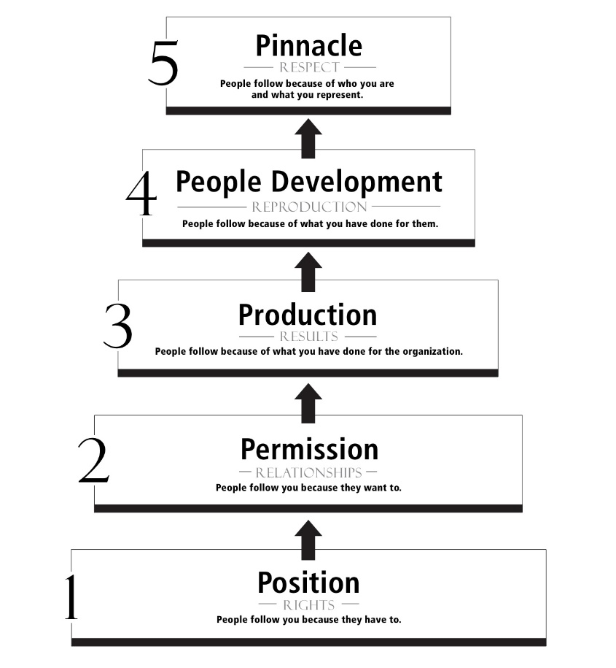
5 Different Levels of Leadership
John Maxwell developed this leadership model that encouraged me over the
years of ministry. Each step of leadership takes time. People will follow you to
the level that you can achieve. When you begin to lead as a new pastor, people
will follow you because you have the position. You have the title of “pastor”.
If you do not develop relationships, your ministry will not advance to level #2
of this ladder and your ministry will stall. Reflect on each of the steps of this
leadership ladder and think about how you can develop the skills necessary to
advance. Every pastor should try to reach level #5 in ministry!
____________________
22. The 5 Levels of Leadership by John Maxwell
22
Step #5- People follow you because you
have a legacy of loving ministry.
The community has been blessed
by your life. They Admire you.
Step #4- People follow you because you
have helped them over the years.
You ministered to their families.
They love you.
Step #3- People follow you because you
have worked hard and the church
has grown. You have produced
fruitful results. They respect you.
Step #2- People follow you because you
have developed relationships
with them. They like you.
Step #1- People follow you because you
have the title. They do not
know you so they follow
out of obedience.
47

Slide 55
8. Visitation
Someone once said, “People don’t care how much you know, until they know how
much you care”. Sometimes pastors view people as interruptions to ministry, instead
of the reason for ministry. We can get so caught up in the busy activity of ministry that
people can be perceived as an interruption. I confess that at times, I have viewed people
as interruptions to my demanding schedule.
The best way to maintain personal contact with your congregation is to schedule time
with them. Here are some ways to stay connected with your congregation:
Hospital visitation- Visit everyone who is in the hospital
Home visitation- Schedule home visits with your members
Special events- Attend birthdays, graduations and other events
Include members- Invite members to go with you on assignments
Visit with people- Any chance you get
It is difficult to love someone you do not know. People will feel unimportant if you do
not make time for them. Remember, the primary call of the pastor is to love! Schedule
some time for your members today!
48

Slide 56
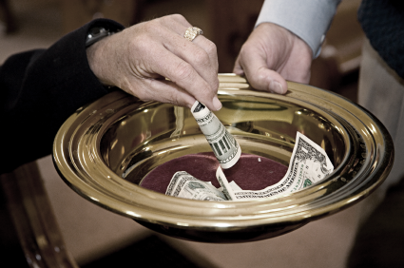
9. Financial Stewardship
How you handle the finances of your church is extremely important. Over the
past twenty years of ministry, I have witnessed different churches fail because the
pastor was not a good steward of the finances of the church!
I knew a pastor who was an awesome public speaker. He had a beautiful family
and the congregation liked him. Everything seemed to be going well, until he made a
financial mistake. In tears he told me his story. One day he collected money from a
special offering, by himself. He was short of money, so he took some of the money
from the offering bag, with the intent of paying it back to the church on payday.
Unfortunately, money was tight, and he could not replace the “borrowed” money. He
intended to pay back the money, but he never did.
One day the church conducted a routine audit, and the discrepancy was discovered.
49

Slide 57
An elder confronted the pastor about the shortfall. Six months had gone
by without replacing the money. Even though the pastor said he had only
“borrowed” the money, the church saw it as theft. Sadly, the pastor lost
his ministry position and the disgrace of being fired impacted his
marriage and he ended up getting divorced.
His story is not uncommon. Many ministries have ended because of poor
financial stewardship. Money can be a stumbling block for anyone!
A pastor needs to live above reproach in his life. If the pastor's reputation is
tarnished, the congregation will lose confidence in his leadership. If
the situation is not corrected the church will stop participating with the
pastor. People will stop giving to the church because they will think the
pastor is mishandling their tithes and offerings. When trust is broken, it is
difficult to regain!
The Pastor should ensure that a system of financial management is
operating in the church. This system should be transparent to the
congregation. Full disclosure is important for accountability! The money
of the church should be guarded with a system of checks and balances.
Do not allow money to destroy your ministry!
50

Slide 58
Here are some suggestions that can help you build a financially safe system:
Never Touch Money: I never receive any money or touch any offerings.
When someone attempts to hand me money, I always
refer them to the ushers or trustees. I never touch money!
Qualified Helpers: Our trustees select the ushers who will receive the
offerings and count the money. Only qualified ushers
handle the money. We always have 4 ushers, never just
one handle the offerings. The ushers are present when the money is counted and then put into a safe with the receipt.
Checks & Balances: The church administrator audits the offering receipts.
Our checking account is monitored by our church
treasurer.
Budgets: The stewardship committee is responsible for the
church budget. All of our ministries have a budget
and must work within their approved line items.
No one has the authority to spend money outside
of the approved church budget. Each year the elders
go on retreat to pray about the vision for the coming
year of ministry. The budget is formed by the elders.
The congregation votes on the new budget.
If you are working in a smaller church, you will have fewer people to create a
system like this. But you must develop a financial system that works for you. Your
financial system should have transparency, a system of checks and balances, an
oversight board, and congregational accountability.
51

Slide 59
10. Church Government
How should the glorious Church be governed? Should all the decisions
be made by the pastor? Does the congregation have any voice in the life of
the Church? Who owns the building, song books, music equipment and
other assets? This question has caused more division than almost any other
issue in Church history. There are four major categories of Church
government with many variations. We will examine the four major structures
of Church government.
1. The Hierarchy Structured Church - Example: The Catholic Church
The Crown Depicts Where the Authority of the
Church Government Resides.
The Pope
Authority resides with the Pope and flows down through the Cardinals, Bishops and Priests to the local congregation.
Cardinals
Priests
Congregation
52

Slide 60
2. The Elder Structured Church -Example: Presbyterian Churches
3. The Congregational Structured Church -Example: Baptist Churches
Authority resides with the elders and flows to the pastor who jointly leads the congregation with the elders. The pastor is considered to be the head elder.
Elder Board
Pastor
Congregation
Authority resides with the congregation which delegates
leadership to the pastor.
Congregation
Pastor
Church Ministries
53

Slide 61
4. The Pastor Structured Church -Example: Independent Churches
Sole authority resides with the pastor.
Pastor
Congregation
The Lord never gave clear instructions about how the Church was to be structured.
Each of these governmental structures have been used to advance the gospel! There are
good churches and bad churches in every structure. Each church structure has strengths
and weaknesses. The pastor needs to understand the type of structure that he is
working in so that he can be effective.
Structure | Property | Doctrine | Voice
Hierarchy | Owned by Rome | Established by Rome | Congregation has no voice
Elder | Owned by the denomination | Established by the denomination | Congregation has limited voice
Congregational | Owned by the local church | Established by the congregation | Congregation is the voice
Pastor | Owned by the local pastor | Established by the pastor | Congregation has limited voice
54

Slide 62
In most structures the pastor is accountable to a board for their
ministry in the church. Working with a diverse group of people can
be challenging. The pastor is normally evaluated by different criteria
chosen by the board. If the pastor works in a denomination, he will
typically have a set of goals established by the denomination. Many
pastors feel squeezed by the demands of the board and the needs of
the congregation. Their own limitations are magnified in the bright
light of unrealistic expectations. Many pastors leave the ministry
because they feel pressured and defeated by the demands of people.
Some pastors rebel and decide to go out on their own. Although that
seems like an easy solution, the results can be devastating. Lone ranger
churches are prone to error and failure. I knew a dynamic pastor that
grew weary of the constraints placed on him by his elder board. The
pastor was young in the faith and bristled whenever the elders
attempted to instruct him. He could not submit to the elders because he
thought he heard from God and did not need additional instruction.
This young pastor left the church, which caused a serious split. His self
centered actions wounded the church that he was called to love. Remember
your calling! A true shepherd never destroys the flock for his personal
ambitions!
55

Slide 63
His lone ranger attitude continued in his ministry and a couple of years
later it caused his new church to implode. Multitudes of people were
wounded by the stubborn attitude of this pastor.
Working with board members is difficult. Sometimes board members
can be petty and seem unable to see strategic vision. Pastors can feel chained by
board members who are more concerned about how things were done in the
past. Someone once said that the famous last words of a church are, “We never
did it that way before”. A great number of pastors leave the ministry every year
because they can not get their board to move forward. Long time board members
have made long term investments in the church, which makes it difficult for them
to let go of their agendas in order to try something new. Ultimately the
health of the church is determined by the ability of the board to work together with
the pastor.
Church government provides safety and stability for the congregation. A lack
of church government creates dangerous lone ranger ministries without any checks
and balances. I do not always like the restrictions of the church board, but I value
the need for the church board and gladly submit my ministry to their leadership.
Ultimately this “iron sharpening iron” is good for the church.
56

Slide 64
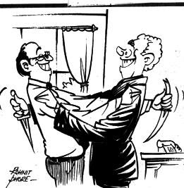
Church Politics
What happens when the pastor and church board are locked in a major
disagreement? Unfortunately, people may resort to politics in an attempt to win an
argument. Church politics is real but not biblical! Many leaders' resort to worldly
tactics in order to get their way. Here are a few of the common political maneuvers:
1. The End Around Tactic: Dissenting opinions attempt to go around the pastor and win approval from other people in
the congregation. This maneuver is not biblical
and causes church division.
The Discrediting Tactic: Dissenting opinions attempt to discredit the
positon of the pastor. Attacks on the pastors
personal life and character may be included
to show that the pastor's position is flawed.
This kind of behavior is ungodly.
The My Way Or Else Tactic: Dissenting opinions threaten to stop tithing
or serving if they do not get their way. This
my way tactic is worldly and very immature.
The Take It or Leave It Tactic: Dissenting opinions threaten to fire the pastor
if they do not get their way. The ultimatum is
take it or leave. This maneuver is also
ungodly.
57

Slide 65
These ungodly tactics can be used by the pastor or by other board members.
The enemy delights in causing strife within the church. He is the accuser of the
brothers and will do everything possible to divide the church over unimportant
issues. Remember to continue to walk in the Spirit during difficult times.
If the church is embroiled in a difficult issue here are some possible solutions:
Invite a trusted leader to visit the church and guide the church toward a solution.
Call the church for a season of prayer and fasting.
Focus on solutions not positions. Don’t attack others! Keep teamwork alive.
The biblical goal of church unity is more important than personal issues.
Be open, honest and willing to hear others.
Pray this prayer before meetings! This is the prayer of Jesus for his church!
Jesus understood the nature of man and knew that his followers would struggle over
difficult issues. Jesus prayed that his disciples would focus on unity so that the world
would believe the gospel. We must all submit to the cross of Jesus Christ for the sake
of the call! He must increase and we must decrease!
“My prayer is not for them alone. I pray also for those who will believe in me through their message, that all of them may be one, Father, just as you are in me and I am in you. May they also be in us so that the world may believe that you have sent me. I have given them the glory that you gave me, that they may be one as we are one I in them and you in me—so that they may be brought to complete unity. Then the world will know that you sent me and have loved them even as you have loved me”. John 17:20-26
58

Slide 66
11. Counseling
Counseling is a vital part of pastoral ministry. People will seek out the pastor for
counsel in many different areas. When I first became a pastor, I was unprepared for
the amount of counseling required in ministry. Here are just a few of the general
areas that a pastor needs to develop for their counseling ministries:
1. Pre-marital counseling - Preparing couples for marriage
2. Marital counseling - Helping married couples grow
3. Family counseling - Helping families in difficult times
4. Financial counseling - Training in finances and budgets
5. God’s Will counseling - Helping people discover God’s will
6. Career/jobs counseling - Guiding people looking for jobs
7. Inner healing counseling - Helping people heal from past hurts
8. Deliverance in counseling - Deliverance from demonic oppression
9. Leadership counseling - Developing leadership skills in people
10. Forgiveness counseling - Coaching people on forgiving others
11. Discipleship counseling - Mentoring disciples for destiny
12. Overcoming sin counseling - Helping people get free from habits
13. Funeral/grief counseling - Nurturing grieving hearts
After twenty years of ministry, I am still learning. I spend time every day attempting
to learn and grow so that I can be a godly source of wisdom for my congregation.
59

Slide 67
There are many different types of counseling available to people.
Contemporary counseling is normally based on psychology and human
understanding. Over the years I have witnessed the lack of genuine
change in people when secular counsel is used.
I believe that only God can change a heart. Since God’s Word has the ability
to transform lives, the pastor should use the Bible in counseling. Peter
encourages us that “His divine power has given us all things pertaining to life
and godliness”. That is an amazing declaration by Peter. He states empathically
that God’s divine power is able to give us all things pertaining to life! Pastor,
use the Bible to impart God’s wisdom in your counseling sessions! The Bible is
like a sharp surgeon's knife, which can cut out roots of bitterness, and
long standing sinful habits. His Word brings hope. His Word transforms
lives! Ask the Holy Spirit to reveal hidden issues. The Holy Spirit will assist
you as you prayerfully listen to the hearts of your congregation.
________________
22. Romans 12:1-2
23. 2 Peter 1:3
24. Grace Bible Institute of Counseling
22
23
Biblical Counseling is the practice of training believers toward greater Christ-likeness through the careful use of the Scriptures for the glory of God.
24
60

Slide 68
Here are some important tips for effective counseling:
Listen more than you speak
Ask questions to reveal deeper issues
Encourage the counselee and give them hope
Assign biblical action steps
Confidentiality is critical
The first issue presented by the counselee is not normally
the issue that needs to be discussed. They will wait to see
if you are safe before revealing the deeper issues. You will
need to learn how to listen for root causes. Many people want
to deal with symptoms. Listen for root causes!
As you listen to the counselee, ask them clarifying questions.
Questions will help the counselee to open up without feeling
violated. Maintain a comfortable and relaxed atmosphere.
As you listen to the counselee, give them encouragement.
Many people suffer with past wounds and tremendous
discouragement. God’s Word gives us hope! “We can do all
things through Christ Jesus our Lord”! Encourage the saints!
The application of God’s Word will bring positive change!
Therefore, the counselor should give the counselee homework.
The homework will help the next session to be life changing.
We must be doers of the Word and not hearers only. The
homework should not be overwhelming, but instead it should be
suited for the individual and their issue.
Do not talk about the counseling session with anyone. Never use
something from a counseling session in a sermon. If you share
information with others, eventually you will get a reputation for
being unsafe. People will stop coming to you for help and some
may leave the church!
61

Slide 69
There are two cautions in counseling! The first caution is to never meet with
the opposite sex alone! A pastor naturally loves people and cares for them. There
is nothing more dangerous than getting emotionally connected to a member of the
opposite sex in counseling! The second caution is trying to counsel someone beyond
your abilities. When you are counseling you will probably come to a place where
you will not be able to help the counselee. It is ok to share with them that you do not
know how to proceed! Let them know that you will research their issue for them and
that you will get back to them with the answer.
It is also appropriate to refer the counselee to advanced counselors if you are not
able to help them. I did this recently! I came to a dead end in marriage counseling
with a couple in my church. I could not help them. They were beyond my ability!
So, I encouraged them to seek counsel with a trained marriage therapist.
The most important factor in counseling is love. The counselee will feel
encouraged if they know that you truly love them. Ephesians 4:2 gives pastors a guide
for every counseling session. It states;
Some Pastors get angry with their members when they fail. Pastors are not supposed to beat the sheep! We are called to love them even in their weaknesses.
“Be completely humble and gentle; be patient, bearing with one another in love.”
62

Slide 70
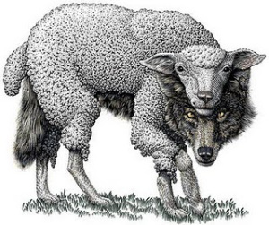
12. Protecting the Church
"Beware of false prophets who come disguised as harmless sheep but
are really vicious wolves.” Matthew 7:14 NLT
“For a time is coming when people will no longer listen to sound and
wholesome teaching. They will follow their own desires and will look for
teachers who will tell them whatever their itching ears want to hear”.
2 Timothy 4:3 NLT
Jesus warned the disciples about wolves in sheep clothing. He used an allegory
to explain that some who look like believers would really be wolves trying to
destroy the flock. The scripture exhorts pastors to protect the flock of God from false
teachers and doctrines of demons. The world is filled with false religions and doctrines
of demons that will attempt to steal your sheep.
A good shepherd will teach their congregation sound doctrine so that when
false teachers come they will be able to defend themselves with the Word of God.
_________________________
25. 1 Timothy 4:1
25
63

Slide 71
Every church should have a statement of faith. This statement describes the
basic doctrinal beliefs of the church. New members that are added to the
church must agree with this statement of faith. This will protect the church
from doctrinal error.
You can protect your church from doctrinal error by using a statement of faith!
Another way you can defend your church from error is by using a comparison chart.
Sample Statement of Faith
National Association of Evangelicals
We believe the Bible to be the inspired, the only infallible, authoritative Word of God. We believe that there is one God, eternally existent in three persons: Father, Son and Holy Spirit. We believe in the deity of our Lord Jesus Christ, in His virgin birth, in His sinless life, in His miracles, in His vicarious and atoning death through His shed blood, in His bodily resurrection, in His ascension to the right hand of the Father, and in His personal return in power and glory. We believe that for the salvation of lost and sinful people, regeneration by the Holy Spirit is absolutely essential. We believe in the present ministry of the Holy Spirit by whose indwelling the Christian is enabled to live a godly life. We believe in the resurrection of both the saved and the lost; they that are saved unto the resurrection of life and they that are lost unto the resurrection of damnation. We believe in the spiritual unity of believers in our Lord Jesus Christ.
64

Slide 72
The following tables compare false religions with Christianity
Christianity Islam
View of God
View of Jesus
View of Salvation
Examination of the Founder
Examination of the Writings
Examination of After life
God is a loving God Allah is unknowable
God is a Tri-unity God is one
Jesus is the only Son of God God had no son
Jesus died on the cross for our sin Jesus didn’t die on the cross
Man is a sinner Man is basically good
Jesus shed blood is the basis for salvation Good works-No salvation
Jesus lived a sinless life Muhammad sinned
Jesus died for others Muhammad killed others
66 books written over 3,000 years Revealed by the angel Gabriel
NO error found in thousands of Internal inconsistency
manuscripts
Hell reserved for fallen angels and for Mass murder ensures
those who reject the gift of eternal life sexual paradise for Jihad
Christianity Jehovah’s Witness
View of God
View of Jesus
View of Salvation
Examination of the Founder
Examination of the Writings
Examination of After life
God is a loving God One God named Jehovah
God is a Tri-unity No Trinity
Jesus is the only Son of God Jesus used to be Michael
Jesus died on the cross for our sin the arch angel
Man is a sinner Works by witnessing and
Jesus shed blood is the basis for salvation be baptized in Jehovah
Jesus lived a sinless life Charles Russell- Feared
Jesus died for others Hell, so he got rid of it
66 books written over 3,000 years The Watch Tower
NO error found in thousands of
manuscripts
Hell reserved for fallen angels and for No Hell- only the grave
those who reject the gift of eternal life Only 144,000 saved
65

Slide 73
Christianity Mormons
View of God
View of Jesus
View of Salvation
Examination of the Founder
Examination of the Writings
Examination of After life
God is a loving God God progressed from man
God is a Tri-unity No Trinity
Jesus is the only Son of God Jesus is the child of father god
Jesus died on the cross for our sin and mother god - brother to
Lucifer
Man is a sinner No salvation without
Jesus shed blood is the basis for salvation Mormon membership
Jesus lived a sinless life Joseph Smith- No salvation
Jesus died for others John the Baptist ordained him
66 books written over 3,000 years The Book of Mormon given
NO error found in thousands of by the angel Moroni
manuscripts
Hell reserved for fallen angels and for 3 Levels of heaven depending
those who reject the gift of eternal life on your works- apostates to
outer darkness
Christianity Hinduism
View of God
View of Jesus
View of Salvation
Examination of the Founder
Examination of the Writings
Examination of After life
God is a loving God A universal spirit- everyone is
God is a Tri-unity a part of god- Brahman
Jesus is the only Son of God Jesus is a guru (teacher)
Jesus died on the cross for our sin Hindus worship idols
Man is a sinner Cycles of reincarnation until
Jesus shed blood is the basis for salvation oneness with Brahman
Jesus lived a sinless life No founder
Jesus died for others No salvation
66 books written over 3,000 years Many different writings
NO error found in thousands of Vedas is most widely known
manuscripts
Hell reserved for fallen angels and for Reincarnation to a better
those who reject the gift of eternal life status (good karma)
Foundation on New Age
66

Slide 74
Christianity New Age
View of God
View of Jesus
View of Salvation
Examination of the Founder
Examination of the Writings
Examination of After life
God is a loving God Everything and everyone is
God is a Tri-unity god. God is a force not a person
Jesus is the only Son of God He is not divine, but a guru. He is not
Jesus died on the cross for our sin a savior, but a model. He did not
physically rise from the dead.
Man is a sinner Offset bad karma with good
Jesus shed blood is the basis for salvation Tap into spirit guides, meditation
Jesus lived a sinless life Based on Eastern mysticism,
Jesus died for others Hinduism and paganism.
66 books written over 3,000 years No holy book. References to
NO error found in thousands of magic, astrology, native American
Manuscripts Taoist, Buddhist and Hindu
Hell reserved for fallen angels and for No heaven or hell, but repeated
those who reject the gift of eternal life reincarnation until oneness
Christianity Wicca
View of God
View of Jesus
View of Salvation
Examination of the Founder
Examination of the Writings
Examination of After life
God is a loving God Goddess
God is a Tri-unity
Jesus is the only Son of God Jesus is mostly rejected
Jesus died on the cross for our sin sometimes considered as a
teacher who taught love
Man is a sinner No need for salvation
Jesus shed blood is the basis for salvation preserve the earth -goddess
Jesus lived a sinless life No one person-practice spell
Jesus died for others casting and divination
66 books written over 3,000 years The book of shadows,
NO error found in thousands of a witches bible
manuscripts
Hell reserved for fallen angels and for The body replenishes the
those who reject the gift of eternal life earth which is the wish of the
Goddess
67

Slide 75
False Religions Church Error Occult Pseudo Science
Islam Witchcraft Dialectical Materialism-Evolution
Hinduism Astrology Scientology
Buddhism Mediums
Secular Humanism Séances
Marxism Channeling
Confucianism Satanism
New Age Voodoo
Mormonism Wicca
Jehovah Witness
Christian Science
Universalism”
Zoroastrianism
Shinto
Taoism
Sikhism
Transcendental Meditation
Hare Krishna
Kabbalah
Seventh Day Adventist
Catholic
Main Line Apostasy
Liberation Theology
Political Correctness
“The Spirit clearly says that in later times some will abandon the faith and follow deceiving spirits and things taught by demons”. 1 Timothy 4:1
There are millions of people that are deceived and trapped in false religions. A good
shepherd will attempt to learn as much as possible about the false religions in their region.
Pastors must protect the flock from dangerous false doctrines! Pastors are the protectors
of the flock! Be on guard for false teaching! Train your congregation in the Word so they
can stand firm in their faith!
The largest false religion in the world is Islam. This is also the most violent religion
in the world. Pastors need to understand the difference between Islam and Christianity!
A comparison of Jesus and Muhammad will provide a clear understanding of the two
religions. This comparison is entitled, Profile of the Prophets.
68

Slide 76
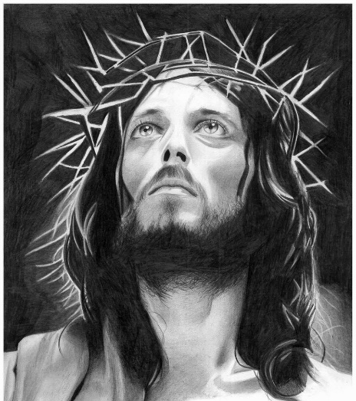
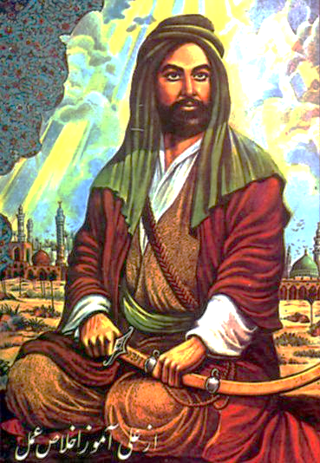
Profile of the Prophets
The world is witnessing an epic battle between two great world religions. Islam
is colliding with Christianity around the world. Many people do not understand why
Islam is in conflict with Christianity. Most people think the two religions should
peacefully coexist. The cultural mindset is this, shouldn’t people be friendly if they
serve the same God? They wonder why we are witnessing so much bloodshed and
destruction surrounding religions of peace?
The religion of Islam is founded on the writings of their sacred prophet, Muhammad.
The Quran is their ancient holy book. The religion of Christianity is founded on the
writings of Jesus of Nazareth in the New Testament of the Bible.
This brief comparison will examine these two prophets in light of their own sacred
texts. We will compare these two prophets using the Quran for Muhammad and the
Bible for Jesus. This is the fairest and intellectually honest way to profile each prophet!
69

Slide 77
Profile of the Prophets- Their Nature
The Bible claims that Jesus is the Son The Quran teaches that Muhammad was
of God with divine attributes. only a human with no divine attributes.
Colossians 2:9 Hirsham pp.68
“For in Christ all the fullness of “Muhammad was born of a normal woman.”
the Deity lives in bodily form.”
According to the Bible, Jesus was born more than a man. Jesus was the incarnation! He
is “God with us”. Jesus claimed to be the Son of God. In John 8:56-58 he tells the
religious leaders that he preexisted Moses!
When the religious leaders heard this claim, they took up stones to kill him. They
fully understood that Jesus claimed to be God. In contrast to Jesus, the Quran
teaches that Muhammad was simply human with no divine attributes.
Your father Abraham rejoiced at the thought of seeing my day; he saw it and was glad.” “You are not yet fifty years old,” they said to him, “and you have seen Abraham!” “Very truly I tell you,” Jesus answered, “before Abraham was born, I am!”
70

Slide 78
Profile of the Prophets- Their Ministries
The Bible claims that Jesus performed The Quran teaches that Muhammad
many supernatural miracles. did not perform any miracles.
John 4:43-54, Luke 7:11-17, Surah 11:31
Mark 8:22-26, Matthew 14:25-33
Jesus healed the sick, opened blind “I do not say to you that I possess
eyes and raised the dead. He even the treasures of Allah, and I do not
commanded nature! know the unseen.”
The Bible clearly teaches that Jesus performed many unusual miracles. Jesus fed
large crowds with very little, he cast out demons, he healed the sick, and he even
commanded the natural elements. He walked on water, silenced a storm and raised
the dead. The ministry of Jesus reflected His divine nature.
The Quran simply states that Muhammad did not do any unusual miracles.
The prophet Muhammad did not walk on water! Muhammad did not feed 5,000
people with a small basket of bread and fish, and he did not heal the sick or cast out
demons. The prophet Muhammad was simply human.
71

Slide 79
Profile of the Prophets- Their Sin
The Bible claims that Jesus was The Quran teaches that Muhammad
without sin. Jesus was sinless. sinned.
1 Peter 2:21 Surah 18:110
“Christ suffered for us, leaving us an “I am only a human like you.”
example that you should follow his steps:
Who did Not sin, neither was any guile
found in his mouth.”
The Bible teaches very clearly that Jesus was a spotless lamb. Jesus was the Son of God
who lived without sin. Jesus defeated Satan in the wilderness and conquered him on the
cross.
Muhammad was a human prophet prone to human faults. Many people thought
that he had gone insane after his encounter with an angel. Muhammad was known
to be angry, harsh, vengeful and committed war crimes. Muhammad was an evil
human.
72

Slide 80
Profile of the Prophets- Their Message
Jesus Christ loved peace. He taught Muhammad was a human who taught war
people how to love and forgive. and revenge.
Matthew 5:38 Surah 2:194
“You have heard that it was said, eye “If anyone aggresses against you, so aggress
for and eye and tooth for a tooth, but against him with the likeness of that which he
I tell you to turn the other cheek if has aggressed against you.”
someone hits you.”
Jesus preached that his kingdom was peace. One of his names is “Prince of Peace”.
Christians are taught to turn the other cheek and to manifest the fruit of the Spirit which
is peace.
Muhammad was a man of revenge. He beheaded those who opposed his message.
He looted his enemies and even took their wives. Muhammad was a brutal man.
73

Slide 81
Profile of the Prophets- Their Sex Lives
Jesus Christ never married. There is Muhammad had numerous wives.
no Biblical evidence that suggests that he had around 10 to 13 wives with 2
he ever got intimate with a woman. He concubines (sex slaves).
was holy and totally celibate.
Most troubling is the fact that he married
Aisha when she was only 9 years old and had
sex with this little girl.
It is of great concern that an old man would marry a little girl and have sex with her.
Our current laws in America would call this an act of pedophilia. If Muhammad would
have married Aisha in America, he would have been sent to prison. It is difficult for me
to understand how this type of behavior can be celebrated by Islam. This act of marrying
young girls is still common today in the Muslim world.
Personally, I do not see anything noble or virtuous about this corrupt heritage
passed down by a pedophile. In contrast, Jesus kept himself pure from any
defilements. He sacrificed personal pleasure in order to fully accomplish His Fathers
will for humanity. Jesus is inspirational and worthy to be followed.
74

Slide 82
Profile of the Prophets- Their Method
Jesus taught his disciples to spread the The disciples of Muhammad were
gospel with love and good works. instructed to kill for their faith.
Christians are to take up their cross and
forsake the world.
Romans 12:14-20 Surah 8:65
“Bless those who persecute you and do “Urge the believers to fight against the
not curse them or harm them.” unbelievers.”
Jesus demonstrated how to respond to evil. He firmly instructed his disciples to turn
the other cheek and to bless their enemies. This is in sharp contrast to dark images of
suicide bombers killing innocent lives in order to gain immediate access to heaven!
The reward for their terrorism is an eternity of sensual pleasure with 72 virgins.
What kind of god runs a spiritual brothel where the payment for erotic pleasure is
innocent blood?
75

Slide 83
Profile of the Prophets- Their Tomb
The Bible and eye witnesses claim The tomb of Muhammad is in Medina
that Jesus resurrected from the grave. under a green dome. Muhammad is
The tomb of Jesus is empty! still in the grave.
Acts 1:1-4
The Tomb of Muhammad
“In my former book, Theophilus, I wrote about all that Jesus began to do and to teach ² until the day he was taken up to heaven, after giving instructions through the Holy Spirit to the apostles he had chosen. ³ After his suffering, he presented himself to them and gave many convincing proofs that he was alive. He appeared to them over a period of forty days and spoke about the kingdom of God. ⁴ On one occasion, while he was eating with them, he gave them this command: “Do not leave Jerusalem, but wait for the gift my Father promised, which you have heard me speak about.”
76

Slide 84
Profile of the Prophets- Conclusion
The Bible teaches that Jesus is the
Son of God who lived a sinless life.
Jesus spent his life loving others and
spreading peace.
Jesus performed many miracles
even raising Lazarus from the dead.
Jesus was crucified on a rugged cross
dying for all humanity including
Muslims.
Jesus resurrected from the grave
on the third day and spent the
next 40 days teaching his disciples.
He loved everyone in the world
and shed his blood on the cross
for the remission of our sin.
He is alive today and will soon return
to the earth to set up his millennial reign!
Jesus is worthy to be worshiped.
The Quran teaches that Muhammad was
born of a natural woman and that he had
no divine attributes.
Muhammad was a fierce warrior who spread
his religion by the sword.
Muhammad was a brutal leader who decapitated
hundreds of prisoners. He taught his disciples
to kill in the name of Allah.
Muhammad died in 632 of possible poisoning.
Muhammad still resides in his grave under
a beautiful green dome in Medina.
Although many people follow Muhammad
and extol him as the final and best prophet,
it is difficult to find any merit for giving
him praise.
The message of Muhammad is opposed to the
life and teaching of Jesus Christ.
77

Slide 85
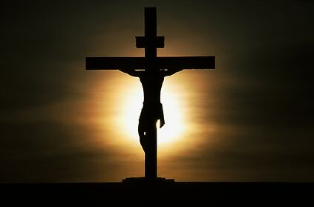
Profile of the Prophets- Application
We live in a historic time. The war between Islam and Christianity is growing
more fierce day by day. Egyptian Christians are being crucified by radical
Muslims. Syrian believers are under severe persecution by Islamic terrorists.
Hundreds of Nigerian girls were captured by Boko Haram a Muslim terrorist
organization. The threat of Iran is at a tipping point.
How are believers supposed to live? I believe we should do everything possible
to stand in solidarity with our persecuted brothers and sisters around the world.
The Church has been silent! I believe we need to become activists for the gospel.
We need to let our voices be heard. We need another Martin Luther King to advocate
for peace. If we do not stand now…then when?
The Love of Jesus The Anger of Muhammad
78

Slide 86
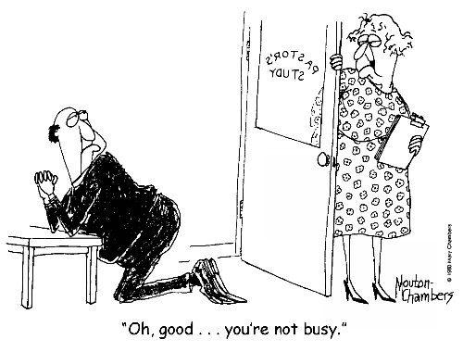
PART THREE:
THE CHARACTER OF THE PASTOR

Slide 87
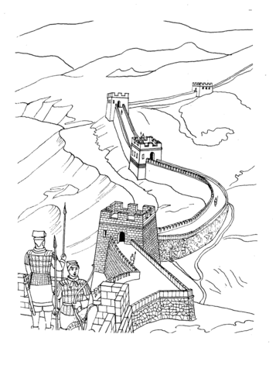
Chapter Three:
The Integrity of the Pastor
One of the ancient wonders of the world was the great wall of China. This
amazing wall was constructed in sections over hundreds of years to defend
China from outside invaders. The great wall of China currently spans over
5,500 miles making it the longest wall in the world. Many believe that the great
wall of China was invincible to outside invaders. But the wall was breached.
How did this amazing fortification fall to invaders? Legend tells us that the wall
was not breached from without, but from within. The opposing vandals bribed
the guards and gained entry without ever firing a shot. The mighty wall of China
could not protect her inhabitants from the frailty of the human heart.
Greed opened the gates of the powerful wall.
The kingdom of God is like the great wall of China. Most people focus
on the brick and mortar of the Church. They marvel at beautiful spires that
dominate local skylines and place their trust in the credentials of Church leaders.
Yet, despite all the beauty of ministry, the human heart is overlooked. Integrity is
overlooked and forgotten. Every year hundreds of leaders fall from ministry
because their hearts were breached like the gates of the great wall of China.
79

Slide 88
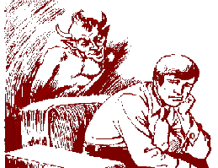
The fleshly guards of the human heart are bribed by the powers of darkness.
The gates of the heart are constantly being probed by darkness.
Most people focus on the brick and mortar of the Church, but fail to see the
secret places beyond public view, where darkness tempts the heart-gates of
the leaders. When the gates of the wall are breached, the inhabitants suffer. As a
consequence of breached hearts in leadership, the Church suffers from the
hands of spiritual vandals.
Leaders at the gate must be prepared for the whispers of darkness. Yet, most of the
preparation for becoming a minister is technical. A pastor’s training typically focuses
on learning how to do the mechanics of ministry. Students learn how to prepare for
a sermon, and how to dress according to the denominational codes. After four years
of training, the young minister graduates from college and eagerly begins to stand
guard over his flock. The enemy stands ready to welcome the new minister to his post.
Slowly the dark vandals will test the heart gates of the new minister to destroy them.
80

Slide 89
I entered full time ministry twenty years ago. Although I had been
trained at a good Bible college, I felt unprepared for most aspects of ministry.
I had to learn how to conduct a funeral with empathy. I had to learn how to
facilitate a wedding with joy. I did not know how to lead committees
successfully. I was not prepared for church politics. I had to go to conferences
to learn about creating vision. I was not prepared for the massive amount of
pastoral counsel needed in a local church.
After twenty years of ministry, I found that the greatest challenge of ministry was
not in the functions of ministry! Maintaining the integrity of my heart is my greatest
challenge in ministry. My heart, like the guards at the great wall of China, feels
the sway of temptation. My heart often seems more concerned about how many
people are attending our church than the individuals who make up our church. If
people leave the church I can feel tempted to quit my post. If the offering is low, I
can feel like a failure. If an attractive woman is present, I can feel tempted. Over
the years I have struggled with my fleshy heart.
I love the Lord and I honestly desire to expand His kingdom with integrity,
but the constant whispers of the dark vandals seeking entrance can be
overwhelming. A daily submission to Jesus Christ is necessary in order to be
filled with the Holy Spirit.
81

Slide 90
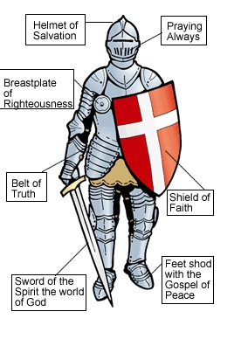
A pastor can often feel spiritually dysfunctional. He can enjoy a
mountain top experience on Sunday, only to fall into a valley of
temptation on Monday. He can feel the sting of personal sin,
while trying to help someone in need. The constant division between
preaching in faith and living in temptation can produce burnout.
You are not alone in your battle over sin and darkness! Even Jesus was
tempted by the devil! The Holy Spirit led Jesus to the wilderness for a
time of prayer and fasting. While Jesus was preparing for his ministry,
the devil appeared to him three times. Each time the enemy attempted to
defeat the integrity of Jesus. It is interesting to note that Satan switched
tactics when he failed. Each of the three temptations tested Jesus in
different areas! This is an important lesson for us to consider. If we
are successful in resisting the devil in one area, be assured that he will
switch his tactics and test you in another area!
I believe ministers are special targets of the
enemy! If a pastor falls into immorality, the
congregation suffers. You must be prepared for
spiritual warfare in ministry!
_________________________
25. Matthew 4:1-11
25
Sword of the spirit, the word of God
82

Slide 91
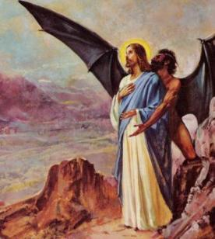
The Three Temptations of Jesus Christ
Body Soul Spirit
Food Satan tempted Jesus to eat food outside of Gods will. | The Pinnacle Satan tempted Jesus to prove his identity by jumping off the pinnacle. | Kingdoms Satan tempted Jesus to disobey God’s plan for redemption by bowing to Satan to gain all the kingdoms of the world.
The test of the flesh. Satan will test our flesh. He will test our integrity by tempting our flesh. | The test of faith. Satan will test your call to ministry. He will challenge your identity and attempt to distort your calling. | The test of obedience. Satan offered Jesus the easy way in ministry. He offered Jesus the kingdoms of the world without the cross!
Attacks on your flesh Sexual immorality Adultery Pornography Gluttony Laziness Financial immorality Lying Cheating & Stealing Learn to appropriate the truth that you have been crucified with Christ! Galatians 2:20 | Attacks on your calling Gossip about you Accusations against you Pride Offenses Anger Envy Performance Politics Know your identity in Christ. Rest in His divine purposes for your life! Romans 8 | Attacks on your obedience Unwilling to bear the cross of Jesus Compromise Man pleaser Religious Career Comfortable Take up your cross and follow Jesus! Be willing to suffer for the gospel! Matthew 16:24
83

Slide 92
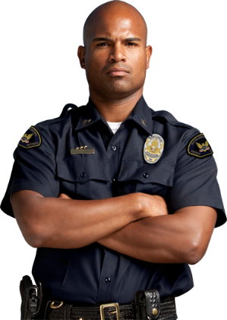
The three temptations of Jesus Christ are continuing today! Pastors should expect
temptations and plan to overcome them. Paul encourages pastors to keep watch over
themselves first, before they attempt to take care of the Church.
“Keep watch over yourselves and all the flock of which the
Holy Spirit has made you overseers. Be shepherds of the Church of God,
which He bought with His own blood.” Acts 20:28
If we do not guard our lives, then how can we help others? A good example of this
principle is demonstrated every time I fly. Before we take off, the flight attendant
demonstrates safety features and then encourages the passengers to put on their oxygen
mask before attempting to help others. The flight attendant then explains that if we
try to help someone else before putting on our oxygen mask, we may faint due to a lack
of oxygen and be rendered useless to help others.
We must guard ourselves before we can help others!
A guard watches over valuable possessions.
The guard protects valuables from thieves.
In the same way, we are responsible to
guard or keep watch over our lives!
We are to be vigilant in watching over our
emotional life, our sexual life and our
spiritual life.
84

Slide 93
Here is a checklist for keeping watch over yourself:
Submit to an accountability partner
Keep your marriage alive
Develop a financial budget
Maintain an exercise program
Take time to go on spiritual retreats
Find time for personal devotions
Enjoy a personal hobby
Take time to rest
Continue to grow
Be open to constructive feedback
Know your weaknesses
Enjoy your family
Develop some strong friendships
Confess your sin daily
Don’t meet with the opposite sex alone
Limit your exposure to media
Be open to counseling
Don’t take yourself too seriously
Find time to laugh
Dream
Maintain a grateful attitude
Ministry is warfare! Pastors need to be prepared for the tactics of the enemy.
Stand firm in the faith and resist the devil!
“Dear friend, I warn you as temporary
residents and foreigners, to keep away from worldly desires
that wage war against your very souls”.
1 Peter 2:11 NLT
85

Slide 94
Chapter Four:
Fellowship with God
The most important thing a pastor can do in the ministry is to
maintain fellowship with God. Moses loved God and was unwilling
to move unless God’s presence moved with him.
All too often ministers make decisions without ever asking if God
is in the decision. Since Jesus is the Master Shepherd, we should
move with his will. If we choose to move without the Lord’s
presence, we are left with hollow rituals. Many churches have
beautifully orchestrated services but the presence of the Lord
is absent. Above everything else, the pastor needs to devote himself
to the Lord.
“Then Moses said to him, “If your Presence does not go with us, do not send us up from here. How will anyone know that you are pleased with me and with your people unless you go with us? What else will distinguish me and your people from all the other people on the face of the earth?” Exodus 33:15&16
86

Slide 95
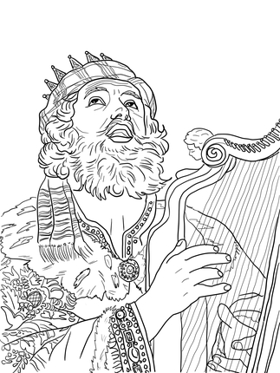
King David loved the presence of the Lord!
David’s primary goal for his life was not the accumulation of wealth or
obtaining power for his kingdom. David’s primary goal for his life
was fellowship with God. David’s ONE THING was God.
What is your ONE THING? Is your primary motive in ministry to build
a big church? Is your primary desire to be powerful? Is your ONE THING
to be liked by everyone? What is your motive for ministry?
Do you honestly hunger to be with God? Do you love his presence?
Are you willing to stay and serve where you are unless his presence goes
with you? Pastors should always seek the presence of the Lord before
they attempt anything for his kingdom!
“One thing have I desired of the LORD, that will I seek after; that I may dwell in the house of the LORD all the days of my life, to behold the beauty of the LORD, and to inquire in his temple”. Psalm 27:4
87

Slide 96
Pursuing His Presence
Confess all known sin to the Lord - 1 John 1:9
Give thanks to the Lord for his grace and mercy - Ephesians 5:20
Worship the Lord in the Spirit – Ephesians 5:19
Wait on the Lord – Psalm 27:14
Hear and Respond to the Voice of the Lord – John 10:27
Give praise to the Lord – Psalm 107:1
David sought the Lord and worshipped him in song. His worship
was so anointed that King Saul found relief from a tormenting spirit.
The Bible tells us that God inhabits the praises of his people. Think
about that for a moment. God responds to our praise! He not only notices
our praise, but he comes to inhabit our praise.
When someone talks about you what would you like them to say?
Do you want them to say that the pastor preaches great sermons? Would you like
to be known as the pastor with a big ministry? Or would you like to be
remembered as the pastor who had a big heart because he loved the Lord!
________________________
26. Psalm 22:3
Enjoying the presence of God should be every pastor’s ambition
26
88

Slide 97
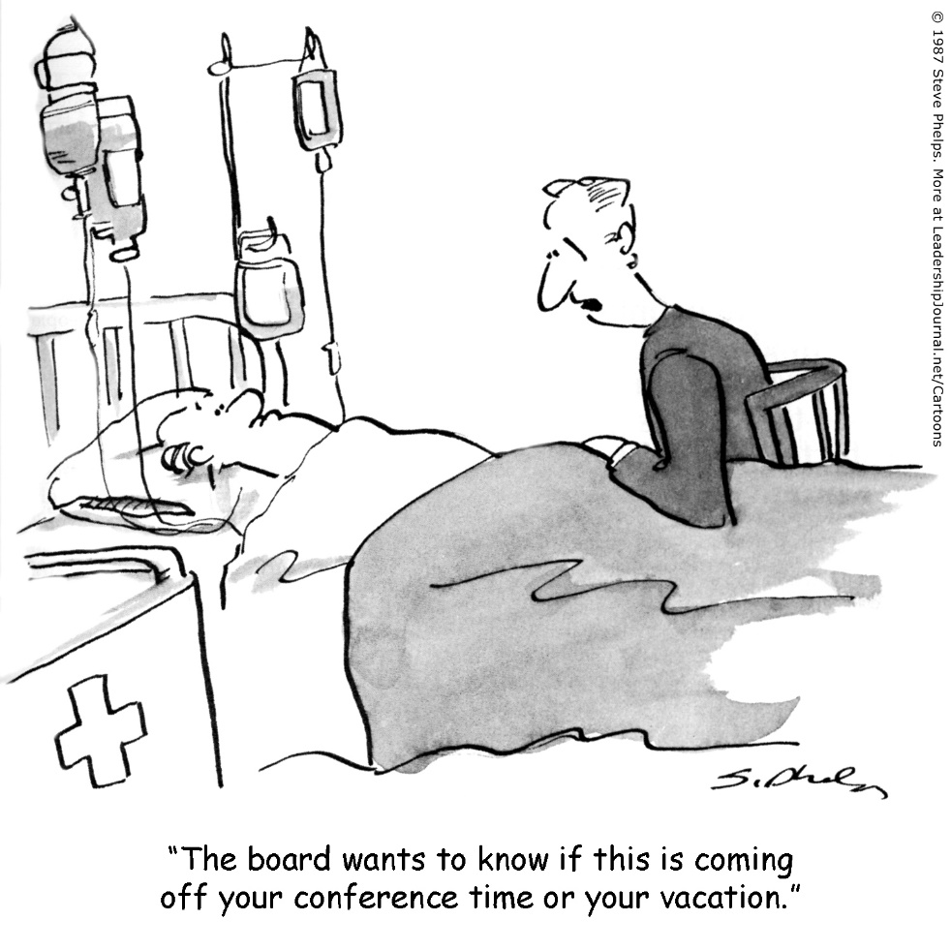
PART FOUR:
THE CHALLENGES OF THE PASTOR

Slide 98
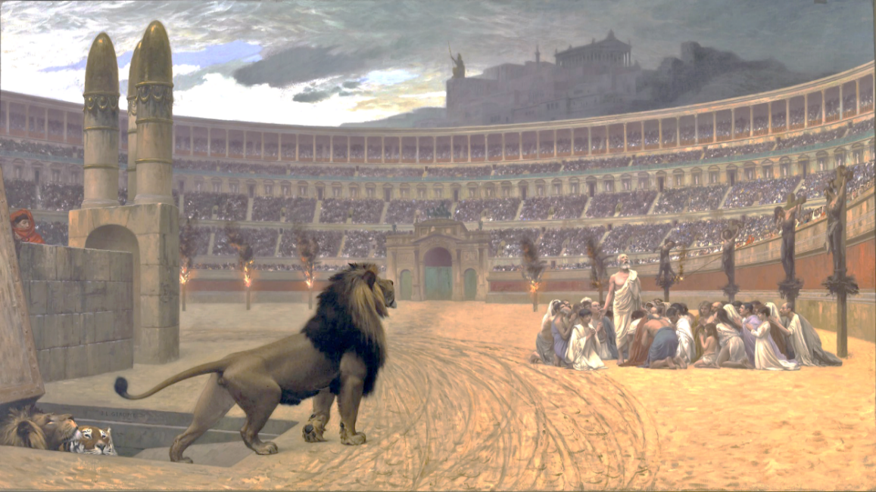
Chapter Five:
External Challenges to the Pastor
1. Persecution of Christians
There has been resistance to the gospel since the very beginning! Darkness hates
the light and will try to destroy anyone who shines in the dark. Jesus warned us about
the persecution from this world. He also encouraged us to be strong and to endure to
the end!
“If the world hates you, know that it has hated me before it hated you. If you were of the world, the world would love you as its own; but because you are not of the world, but I chose you out of the world, therefore the world hates you. Remember the word that I said to you: ‘A servant is not greater than his master.’ If they persecuted me, they will also persecute you. If they kept my word, they will also keep yours. But all these things they will do to you on account of my name, because they do not know him who sent me.” John 15:18-25
“Do not be surprised, brothers, that the world hates you” 1 John 3:13
89

Slide 99
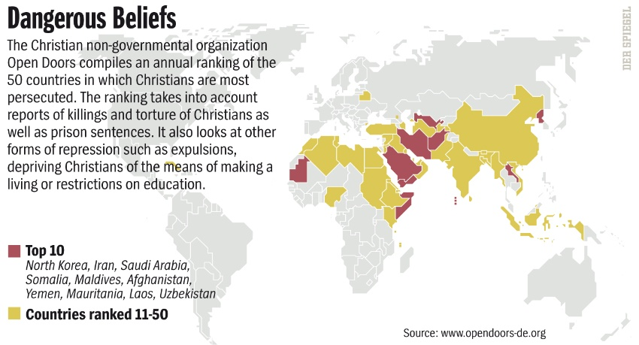
“Blessed are those who are persecuted for righteousness' sake, for theirs is the kingdom of heaven”. Matthew 5:10
“Beloved, do not be surprised at the fiery trial when it comes upon you to test you, as though something strange were happening to you. But rejoice insofar as you share Christ's sufferings, that you may also rejoice and be glad when his glory is revealed. If you are insulted for the name of Christ, you are blessed, because the Spirit of glory and of God rests upon you”. 1 Peter 4:12-14
“Indeed, all who desire to live a godly life in Christ Jesus will be persecuted”
2 Timothy 3:1
All around the world Christians are being persecuted for their faith!
Thousands of believers are martyred every year. If you live in a country that is
predominately Muslim or Hindu, persecution is likely. A pastor needs to be sensitive to
persecution activity in their region.
90

Slide 100
Pastors need to protect their congregation from persecution as much as
possible. The early Church met in catacombs for worship in order to evade
persecution. The Lord commanded his apostles to be as gentle as doves
but to be wise as serpents in dealing with the world.
Several years ago, I was leading a mission team conducting night crusades
in India. One evening we were preparing for our gospel crusade when
a large group of Hindu’s surrounded us in black robes and large canes.
Their faces were painted, and they seemed very agitated about our presence
in their village. They threatened to beat us if we did not leave their village.
I was ready to give my body to their canes, but I was also responsible for
the others on my team. So, I asked our team to leave. Their protection was
prominent in my decision.
Two years later we were invited to come back to that village. The village
apologized for their rude behavior and allowed us to do open air preaching.
That night many villagers came to saving faith in Jesus Christ. We were invited
back to the village because we remained humble during the “beating threat”. We
did not agitate or combat the angry Hindus. Our gentleness opened the door for
the gospel of Jesus Christ and no one was hurt in the persecution.
91

Slide 101
2. Persecution from Christians
One of the greatest challenges to Pastors comes from the Church itself.
The military calls this type of challenge, “Friendly Fire”. Many causalities
occur from friendly fire. Friendly fire occurs whenever troops are mistakenly
targeted and wounded by their own forces.
Jesus took friendly fire from his disciples. His disciples doubted him and
even challenged his mission. At one point Jesus told Peter that Satan
had spoken lies through him. Jesus was verbally assaulted by Peter.
People will question you and challenge you. Sometimes they will be
motivated by darkness to hurt you. Peter loved the Lord but was influenced
by darkness and wounded Jesus. This type of friendly fire is normal in
ministry. Pastors need to know that people will be unkind.
“Jesus turned to Peter and said, "Get away from me, Satan! You are a dangerous trap to me. You are seeing things merely from a human point of view, not from God's.“ Matthew 16:23
92

Slide 102
The apostle Paul also experienced friendly fire. At the end of his life the apostle writes
to Timothy for a final time. In his last letter he mentions people who had hurt him and
deserted him.
It is obvious from this passage of scripture that Paul had been hurt in ministry. The
Bible is filled with instances of friendly fire. Miriam ridiculed and challenged Moses,
Lot was contentious with Abraham and Judas betrayed Jesus. Friendly fire is common
in warfare and in ministry!
Friendly fire may be the most painful wound because it comes from our friends. Pastors
need to forgive freely so that offenses do not develop. Jesus continued to love Peter.
Moses continued to love Miriam. Abraham continued to love Lot. Pastors must
continue to love those that hurt them! This is a very difficult part or our calling!
“ Timothy, please come as soon as you can. Demas has deserted me because he loves the things of this life and has gone to Thessalonica. Crescens has gone to Galatia, and Titus has gone to Dalmatia. Only Luke is with me. Bring Mark with you when you come, for he will be helpful to me in my ministry. I sent Tychicus to Ephesus. When you come, be sure to bring the coat I left with Carpus at Troas. Also bring my books, and especially my papers.
Alexander the coppersmith did me much harm, but the Lord will judge him for what he has done. Be careful of him, for he fought against everything we said.
The first time I was brought before the judge, no one came with me. Everyone abandoned me. May it not be counted against them”.
93

Slide 103
When you get hurt by a friend, do not quietly nurse the wound. If you stuff the pain
it will grow and cloud your perspective. You will begin to assign evil motives to the
person who hurt you. They will notice your changed attitude toward them! They will
begin to assign evil motives about you and will share their hurt with others. Soon the
church will be talking about you! People will add their opinion to the story! Their
revised edition of the story will become more sinister. People will take up offenses
against you, even though you are innocent of their animosity!
I have walked this road many times! I have learned that when your emotions
are filled with the poison of bitterness, your relationships with everyone will suffer!
I have also learned this important principle; Your response to the situation is more
important than the situation! Think about that statement for a moment! Your response
will determine your destiny! Your response to unfair criticism is more important than
the criticism. Your response to ugly rumors is more important than the rumors. This is
true because you can control your response. If you react in anger to unfair criticism, the
situation will only get worse. But if you respond with wisdom and grace, the situation
will improve. How do you handle mistreatment from others? Are you overly sensitive?
Do you explode in anger to negative accusations? Or do you silently nurse your wounds?
Every person is unique and reacts to pain differently. The key to successfully dealing
with unfair criticism is to turn to the Word of God for direction!
94

Slide 104
A Biblical Guide for Responding to Hurt
1. Proverbs 3:5-6 Trust in the Lord in every circumstance!
2. Romans 12:19 God is the judge! Release the offender to him for judgment!
3. Ephesians 4:32 I am to forgive freely just like Jesus forgave me!
4. Colossians 3:12 We are to learn how to bear with one another in our imperfections!
5. Romans 5:3-5 The Lord is building character in my life through difficult moments!
6. James 1:19 Be slow to speak, quick to listen and slow to anger!
7. Hebrews 12:15 Do not allow a root of bitterness to grow in my heart!
8. 1 John 1:9 I am to confess my sin and not worry about another's sin!
9. 1 Peter 5:7 I am to cast all my care, concerns and hurts to the Lord!
10. Philippians 4:7 The peace of God will rule my heart if I give him my hurts!
11. Matthew 18:15-19 I am to confront my brother for any sin committed against me!
12. Romans 8:28 All things will work together for good if I continue to trust!
13. Romans 12 Respond in kindness to those who hurt you! Pray and bless them!
Whenever I get hurt, I immediately focus on the scripture instead of focusing on the
person who hurt me! I will become bitter if I rehearse the wound. So, I choose to read
the scripture and obey them. I choose to follow the scriptures in this Biblical guide for
responding to hurt. God’s Word can protect our heart from developing offenses! We have
a choice! We can choose to live our lives in the Word, or we can live our lives by our
fickle feelings!
95

Slide 105
3. Provision Challenge
One of the biggest challenges to ministry around the world is the lack of provision.
Most village churches do not know the biblical principle of tithing. Most village pastors
do not have the resource's needed to expand their ministries.
Tithing is not just for America! This kingdom principle is universal! I witnessed
members of a leper colony tithe rice during a church service in India. Their tithe of
rice was costly to them! But their contribution enabled the pastor to spend more time in
ministry because of their generosity. The result of their tithing was very evident, the leper
church was flourishing! Another example of tithing being discovered in remote regions
of the world comes from China.
The Chinese police were frantically searching the region trying to find the seven uncles.
The seven uncles were the seven fathers of the underground church of China. These seven
men led fifty-two million believers. The Chinese authorities wanted to capture these
renegades. Far away in an isolated farm the uncles gathered with fifty other leaders
including two American missionaries. This secret rendezvous of leaders met to determine
how to fund the missionary movement of this expansive underground network. Howard
Foltz the founder of AIMS and Dennis Jones were awakened by the moan of intense
intercession at 4:00 in the morning. The Chinese pastors were in fervent prayer.
96

Slide 106
Dennis listened to these men intercede for the church. Men that had been tortured by
the communists. In the early morning shadows as pastors were praying, a beam of light
from the fireplace would illuminate a disfigured face. The communists had cut off his
nose. Another pastor raised his arms in prayer revealing hands without fingers. Dennis
felt the sting of conviction as he watched these courageous pastors contending for their
church. These men displayed the scars of spiritual warfare in their bodies.
I sat motionless as I listened to Dennis telling me about his encounter at that remote
farmhouse. These precious men were totally committed to expanding the Kingdom
of God without regard for their own welfare. These men had been beaten and tortured
for their faith. They were totally committed to the gospel. I sat at a nice restaurant
listening to this amazing story. Believers dressed in brand named clothes and Rolex
watches dined on expensive gourmet food. The food lost its appeal as I thought about
these pastors. How could the Kingdom of God be so divided on earth? How could the
Church of China be so poor and persecuted while the Church in America was so affluent
and free? Dennis continued his story in between bites. The uncles were praying for
the windows of heaven to be opened so that the mission's effort would be totally funded.
After some lengthy discussion, the uncles humbly asked the two American missionaries
how they should fund their mission's movement. Dennis responded by saying that the
underground church of China should not expect help from the West. Instead, the
underground Church would have to learn how to give. Upon hearing his reply, the
Chinese leaders hung their heads and mumbled, “our people do not give, we are poor”.
97

Slide 107
This confession immobilized the room. These humble leaders who had bravely
endured brutal persecution, sat defeated. These brave men endured inhumane treatment
for the sake of the gospel. Nothing could silence them, except a lack of generosity in the
church. Because the church did not have a theology of giving, the gospel suffered. The
brief silence seemed like an eternity.
Dennis broke the deafening silence with a profound challenge. He asked, “Can every
member of the underground church give one dollar in one year”. After a moment of
reflection, one of the uncles said yes. Every member of the underground church
could give one dollar in one year! But what good would that do, he followed?
With a happy grin Dennis replied, “If every member of the underground church of China
committed to give one dollar, in one year, the total amount raised would be fifty-two million
dollars”! The Chinese pastors perked up and began to chatter. The room was filled with
hope. The Church of China did not need handouts from the West, they could harvest the
money needed for their missions' efforts in their own back yard. The church of China could
support its own missions' efforts. Tithing is for everyone!
“Will a man rob God? Yet you have robbed Me! But you say, ‘In what way have we robbed You?’ In tithes and offerings. You are cursed with a curse, for you have robbed Me, even this whole nation. Bring all the tithes into the storehouse, that there may be food in My house, and try Me now in this,” Says the Lord of hosts, “If I will not open for you the windows of heaven and pour out for you such blessing that there will not be room enough to receive it”.
Malachi 3:8-10
98

Slide 108
Chapter Six:
Internal Challenges to the Pastor
Pastors not only face external challenges in their ministry, but also face internal
challenges. Even after twenty years of ministry I continue to battle with internal
challenges! Pastors face many different kinds of internal challenges. Here is a
general list of some of the internal challenges that a pastor may face in ministry:
1. Inadequacy- A feeling that you are not good enough to adequately
fulfill your role as a pastor. You watch other pastors
and measure yourself by their gifting's.
2. Unsuccessful- A sense that you have been unsuccessful as a pastor.
You measure your success by the size of other ministries.
If you see a church that is larger than yours, you may feel
like a failure. What is a success in ministry?
3. Unforgiveness- The inability to forgive others who hurt you. Continuing
to hold a grudge. Struggling with angry emotions.
4. Control- Some pastors struggle with control. Do you have to control
everything in the church? Do you always have to get your
way?
5. Depression- Many pastors lose their zeal for ministry and become
depressed. The joy of ministry is lost to gloom.
6. Integrity- Every pastor has an old nature. Every pastor has to learn to
overcome sin in their lives. Pastors will never be sinless, but
we are called to walk in integrity.
7. Lack of Faith- Pastors can develop a faith crisis when they constantly witness
loss and pain in the lives of others.
Do you see any of these challenges in your life? We all have internal challenges.
Remember, the key to growth is honesty!
99

Slide 109
Inadequacy
Moses felt inadequate for the call on his life. Read this amazing passage from
Exodus 3:1-14 about how God encouraged a man full of inadequacy!
God called Moses to deliver Israel out of Egypt. Moses responded to God’s call
with inadequacy. He said, “Who am I?” I believe all ministers are inadequate to
successfully fulfill their call without God. God spoke to Moses and told him that he
would be with him to accomplish this calling! I know that I can not fulfill my calling
without God’s divine help! Inadequacy is simply a reminder that we need to trust God.
I need to be filled with his purposes, his power and his presence in order to do what
he has called me to do. So, whenever you feel inadequate, that is a good thing! Pray
for divine enablement and trust the Lord to accomplish his purposes in your life!
The Lord said, “I have indeed seen the misery of my people in Egypt. I have heard them crying out because of their slave drivers, and I am concerned about their suffering. So I have come down to rescue them from the hand of the Egyptians and to bring them up out of that land into a good and spacious land, a land flowing with milk and honey—the home of the Canaanites, Hittites, Amorites, Perizzites, Hivites and Jebusites. And now the cry of the Israelites has reached me, and I have seen the way the Egyptians are oppressing them.
So now, go. I am sending you to Pharaoh to bring my people the Israelites out of Egypt.”
But Moses said to God,
“Who am I that I should go to Pharaoh and bring the Israelites out of Egypt?”
And God said, “I will be with you”.
100

Slide 110
Unsuccessful
What makes a pastor successful in ministry? Many people believe that a pastor is
successful if they have large congregations with big budgets! They surmise that God
must be blessing them if they have a new church facility filled with people! If “big” is
the ruler for success in ministry, then small must mean failure? This false assumption
causes many pastors to feel shame and discouragement. The median church size in
America is around 80 people. According to national statistics approximately 60% of
the churches in America have congregations around 100 people. Are all of these
pastors a failure because their churches haven’t grown to become a mega-church?
What is the measure of success for a pastor in ministry?
Most people would say that Jesus Christ was successful! So, how many disciples
remained in his church by the end of his life? It may surprise you to find that there
were only 120 people that remained in the upper room after Jesus ascended to the Father.
After three years of ministry, Jesus only had a church of 120 people! Was Jesus a
successful pastor? The obvious answer is YES!
Jesus was a success because of his obedience to the will of the Father. The Lord is
looking for faithfulness not stardom! If you pastor a small church, be encouraged!
God’s measure of success is faithfulness to his call!
____________________________________
27. Hartford Institute for Religion Research
27
101

Slide 111
Unforgiveness
“Unforgiveness is like drinking poison and hoping the other person dies”
Margaret Stunt
John Bevere, a well-known author, writes this about unforgiveness: “It doesn’t
matter how up-to-date you are in new revelations from the many seminars and Bible
schools you’ve attended or how many books you’ve read or even how many hours
you pray and study. If you are offended and in unforgiveness and refuse to repent of
this sin, you have not come to the knowledge of the truth. You are deceived, and you
confuse others with your hypocritical lifestyle. No matter what the revelation, your
fruit tells a different story. You will become a spring spewing out bitter waters that
will bring deception, not truth.”
The Bible exhorts us to deal with our anger and hurt immediately. We are to deal
with it before sunset. If we choose to hold on to offenses, we open our lives to
increased harassment from the enemy.
Pastors will have many opportunities to be wounded in ministry. If we do not forgive
others when we are hurt, our hearts will become filled with bitterness. Remember the
cross of Jesus? Jesus in his agony looked down from the cross and said, “Father forgive
them for they know not what they do.”
“And “don’t sin by letting anger control you. Don’t let the sun go down while you are still angry, for anger gives a foothold to the devil.” Ephesians 4:26,27 NLT
102

Slide 112
Control
“The best leader is the one who has sense enough to pick good men to do what he wants done, and self restraint enough to keep from meddling with them while they do it.” Theodore Roosevelt
Jesus empowered his disciples! Jesus did not attempt to control everything in his
earthly ministry. Jesus delegated authority to his disciples to expand the kingdom.
Many pastors have a difficult time delegating responsibilities to others. The fear of
losing control keeps them from empowering their church members. Insecure people
normally have a difficult time delegating responsibility to others.
Pastors who attempt to do all the work of ministry usually burn out in time. The Lord
desires to see every member active in ministry. He sent the Holy Spirit to empower
average people with spiritual gifts. These spiritual gifts are for ministry! When a
pastor empowers someone for ministry, his reach is multiplied. Church growth
experts suggest that one pastor can reach a maximum of 150 people. Perhaps that is
why a majority of churches in America are around 100 people. If a pastor trains
another leader and empowers them, then their combined reach could grow to 300 people.
Jesus understood this principle and spent the majority of his time training twelve
disciples. Eleven disciples filled with the Holy Spirit eventually transformed the
ancient world.
“When Jesus had called the Twelve together, he gave them (delegated) power and authority to drive out all demons and to cure diseases, and he sent them out to preach the kingdom of God and to heal the sick”.
103

Slide 113
Depression
Elijah had just defeated the prophets of Baal on Mount Carmel. He had won a
tremendous victory! Exhausted from this ministry encounter with the false prophets
he received news that his enemy threatened to kill him. Elijah ran to the desert and
wanted to commit suicide. He told the Lord that he wanted to die!
Elijah was Depressed
Discouragement and depression are common in ministry. Elijah’s depression was
caused by overwork and extreme pressure. He felt like he was the only one standing
for truth in the nation. Elijah cracked under this intense pressure and ended up alone in
a desert. The Lord helped Elijah overcome his depression. The Lord never condemned
Elijah for feeling discouraged. Instead, the Lord gave Elijah a new purpose on Mount
Horeb. Elijah was refreshed in the presence of the Lord on the mountain!
It is essential that pastors find a Mount Horeb to be refreshed in the Lord. Elijah
left Mount Horeb with renewed purpose and successfully fulfilled his ministry! Even
Jesus spent time away from the crowds. If the Messiah spent time alone from the
demands of ministry, so can we! King Solomon teaches us that a sharp axe cuts more
wood! You can do twice the amount of work with less effort if you simply sharpen
the axe. A dull axe takes more effort to cut less wood. In the same way, the axe of our
ministry can cut more wood if we take time to be sharpened! Find your Mount Horeb
and be refilled and sharpened for his purposes!
______________________________
1 Kings 1
Ecclesiastes 10:10
28
29
104

Slide 114
Integrity
“And David shepherded them with integrity of heart; with skillful hands he led them.”
Psalm 78:72
This scripture may sound a little odd. Kind David shepherded them with integrity?
I can hear the mumbling in your thoughts! How did the guy who killed his friend in
order to cover up an affair have integrity? King David is famous for his infidelity with
beautiful Bathsheba! Yes, King David sinned a great sin. Yet when confronted with his
sin, he admitted it and repented. David did not try to blame others for his sin or deny his
sin, but instead took full responsibility for his behavior.
Integrity is not the absence of sin! Integrity is taking responsibility for our actions
and being accountable for them. Many pastors will not commit David’s sin, but many
of those same pastors will not walk in integrity. I know many pastors who are not
accountable for anything that they do. They see themselves as untouchable leaders
instead of servants. David walked in humility and had a contrite heart. David walked
in integrity not sinless perfection.
Pastors should walk above reproach. Pastors should pursue righteousness and a
holy life. But pastors must also be humble enough to be accountable when they
make mistakes. Are you accountable to others? Do you always have to be right?
Do you allow others to speak into your life? Are you walking in integrity?
105

Slide 115
Lack of Faith
Pastors deal with life emergencies more than most people with the possible exception
of doctors. The constant drain of people pulling on your faith can make you dry. A lady
with an issue of blood touched the hem of Jesus garments and was healed. Jesus turned
and asked, “who touched me”? Jesus felt power leave his body when the woman touched
his garment (depleted).
In the same way we can feel depleted through all of the tragedies and difficult
times of ministry. When we don’t see an answer to prayer and a child dies in her moms
arms faith can be depleted. When we pray for provision, but the budget is still strained,
we can feel depleted. When we believe God for a great harvest of souls, but very few
come to the Lord we can feel depleted. Depleted faith can cause pastors to hide in their
liturgy. Pastors can begin to recite prayer as part of a liturgy instead of believing that
God will answer their prayer. This is dangerous because faith can turn into religion.
Ministry can deplete you until you are totally empty. Many pastors will experience
emptiness and a lack of faith. Depleted pastors often struggle with their faith and their
calling. The key to being revitalized is to get alone with God. A fresh encounter with
the Lord will replenish your empty heart. Some pastors focus on attempting to enlarge
their faith when they are depleted. We do not put faith in our faith!
“As Jesus was on His way, the crowds almost crushed Him. And there was a woman there who had been subject to bleeding for twelve years, but no one could heal her. She came up behind Him and touched the edge of His cloak, and immediately her bleeding stopped. ‘Who touched Me?’ Jesus asked. Jesus said, ‘Someone touched Me; I know that power has gone out from Me.’ (depleted) Luke 8:43-47
106

Slide 116
The famous evangelist Reinhard Bonnke says, “It is not the size of your faith, but
the size of your God that determines results”. The American view of God is very small.
When I was traveling in India on a mission's trip, I saw a little elephant on the dashboard
of the taxi. Wanting to make conversation with the cab driver, I inquired about the little
silver elephant. He replied that it was his god. Silently, I mused that he had a very little
god.
On the way back home, traveling at 37,000 feet, I reflected on this moment. I felt
the Lord whisper to me that many Americans also had a small view of God. Many
believers have a dashboard Jesus. They don’t mind a Jesus in a sermon. They don’t
mind singing about Jesus, as long as it isn’t personal. They simply do not see Jesus as
portrayed in the book of Hebrews. Jesus is not the creator and king of the universe.
It is easier to have a convenient dashboard Jesus that we can control. Keep Jesus in
a religious ritual, or historic creed. Just do not let him off of the dashboard and into my
life.
Many believers emphasize having a great faith but having a small God. If we focus
on building a great faith in ourselves while holding to a dashboard Jesus view of God,
then we are merely Christian Humanists. Jesus said that a tiny seed of faith like a
mustard seed could move mountains. He was teaching his disciples to remember that
it was not the size of their faith, but the size of their God that made the difference.
Have you lost the wonder of God? How big is your perspective on God? He can fill
you up to overflowing.
107

Slide 117
3. The Challenge of Different Congregational Sizes
The Boeing 757 banked through heavy clouds in its final decent to Iquitos, Peru.
The Amazon team weary from the long flight from Atlanta, Georgia awoke from
the bumpy turbulence. Looking out of the window I saw the familiar sight of
a sea of green jungle for as far as you could see in any direction. Our team was excited
about sharing with these untrained pastors in the winter leadership conference.
A deep sense of responsibility filled my heart. These pastors are isolated from the
world and receive very little encouragement or training. “Lord” I muttered, “please
help us strengthen these precious men this week”.
I pondered some of the leadership principles that I was studying for this trip.
Some of our leadership principles are universal and can apply to any culture. But,
some leadership principles seem difficult to convey in a cross-cultural context. I
remember the founding missionary couple, Mike and Susie Dempsy telling me that
the Peruvian pastors did not understand John Maxwell training videos. The pastors
desperately needed to learn leadership concepts, but just could not grasp some of the
Maxwell principles presented in the training videos. So, they asked me to conduct
an annual leadership conference for these precious village pastors.
108

Slide 118
I have been a John Maxwell fan for many years and have grown under his
incredible ministry. So, my intent is not to diminish John Maxwell, but to suggest
that many of our North American leadership concepts do not always translate into
remote village mindsets. Here is a basic cultural barrier that our concepts need
to cross before we can effectively train others in third world regions.
Village Simplicity
The average church size in a village is about 10-25 people. The pastor usually
works a full-time job and does not have time to devote himself to office hours.
He does not have a staff to manage his church. Life revolves around the
simplicity of village life. Daily hunting and fishing take up large amounts of time.
Village life is simple. Complex ministry models typically will not work in this
environment. Villagers move in rhythm with nature. They begin their day at sunrise
and end their day at sunset. Villages are small communities where everyone knows
everything about everybody! Reputations are known by everyone in the village.
People retell stories about other people for entertainment. A village pastor will be
observed by everyone! Jesus ministered in similar circumstances. Over 90% of his
ministry was around the sea of Galilee. Village pastors should pay particular attention
to the life and ministry of Jesus Christ. He successfully ministered in small villages!
109

Slide 119
Jesus was very relational and spent most of his time with people. He lived in the
village of Capernaum located on the northern shore of the Sea of Galilee. He ate
with the people, celebrated weddings with the village and attended worship services
at the synagogue. His ministry grew through personal contact. Jesus did not have
modern technology for ministry. These villages were simple and poor. So how did
Jesus accomplish his world-changing ministry in simple surroundings?
He developed loving relationships
He kept a pure reputation
He prayed with faith producing miracles
He met common needs
He preached with authority
Jesus is the Son of God and has divine power to accomplish God’s will. He did
many miracles in these Galilean villages. Villagers did not want a complex religion
they wanted power for daily living. The same Holy Spirit that was in Jesus Christ
is available to every pastor in the world. God still performs miracles. God does not
change! The Holy Spirit is still available to heal, deliver and provide!
The crowds grew under the ministry of Jesus. Jesus began to appoint disciples to
help him with the growing crowds!
“Jesus Christ is the same yesterday, today, and forever” Hebrews 13:8
110

Slide 120
Jesus easily ministered to small groups at the beginning of his ministry. When
the crowds exploded; Jesus had to use different leadership skills. Jesus began to
develop his leaders so that they could assume ministry responsibilities. He began
to delegate assignments to his disciples!
The crowds of people became too big for one person! These principles are still true
today! The skills necessary to lead a group of 15 people is far different than the
skills required to lead a church of 3,000 people.
Gary McIntosh wrote an amazing book about successfully ministering in churches
of different sizes! His book entitled “One Size Doesn’t Fit All” has been a tremendous
blessing to me. I have been a pastor of a church of 125 members, a church of 400
members and I have been an associate pastor of a mega church of 2,300 people.
Each one of these different sized churches required a different leadership focus.
This is especially true for small village congregations. Pastoring churches of different
sizes is very challenging. Leading a church of 25 people requires different skills
than leading a church of 400 people. Jesus successfully transitioned his leadership
from small groups to massive crowds. Pastors need to learn how to transition their
churches to the next level!
111

Slide 121
Gary McIntosh’s Typology of Church Sizes gives a vivid overview of the different
leadership skills needed for different congregational sizes.
_____________________________
30. One Size Doesn’t Fit All by Gary McIntosh
30
Factors | Small Church | Medium Church | Large Church
Size | 15-150 | 151-400 | 401 +
Focus | Relational | Program | Organizational
Leadership | Resides in key families | Resides in select committees | Resides in select leaders
Staff | Bivocational pastor | Pastor and small staff | Pastor with multiple staff
Change | Bottom up through key families | Middle out through committees | Top down through key leaders
Growth | Attraction through relationships | Programs through signature ministries | Advertising and marketing of reputation
Obstacles | Lack of ministry capital, image, ineffective outreach | Increasing complexity, poor administration, inadequate staff and facilities | Poor assimilation, increased bureaucracy, poor communication, lack of member care
112

Slide 122
Gary McIntosh’s understanding of different congregational sizes helped me in
my own ministry as well as in training village leaders. A pastor of a small church in
a remote village needs to concentrate on relational ministry, instead of focusing on
leadership principles that do not apply to their context or community.
I changed my focus to relational leadership principles for these pastors. This change
seems to have made a difference. Although I do not have any empirical evidence
supporting this claim, I have heard several testimonies about how village pastors are
excited about trying these new principles back in their remote communities.
Relational leadership is different than organizational leadership. Organizational
leadership requires knowledge of organizational structures and the policies needed to
empower the model. Relational leadership focuses on interpersonal skills and integrity.
A pastor of a large church is challenged to maintain the organizational model, while a
pastor of a small church is challenged to be connected with a small group of people.
A congregation of fifteen people in the remote Amazon jungle does not need a complex
organizational structure. Instead, they are concerned about daily provision, and family
needs.
A successful village pastor needs to learn how to care for the needs of his small
flock. This is also true for pastors in India, Egypt, Africa or in any region of the world.
113

Slide 123
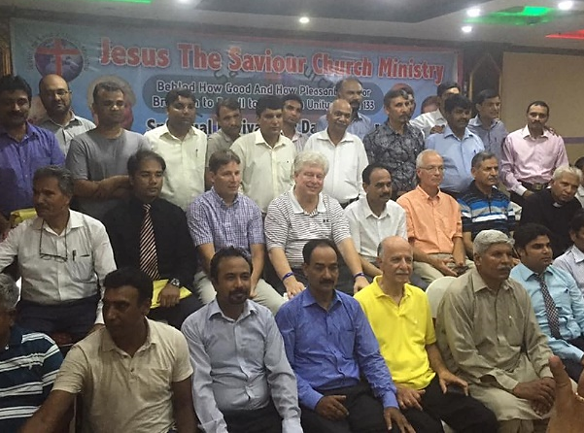
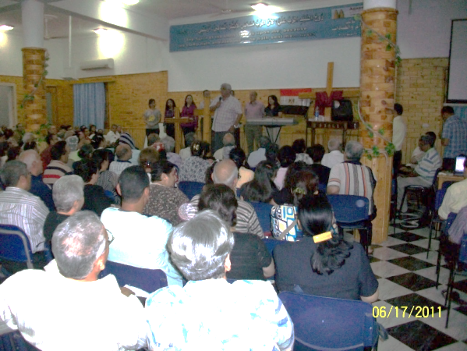
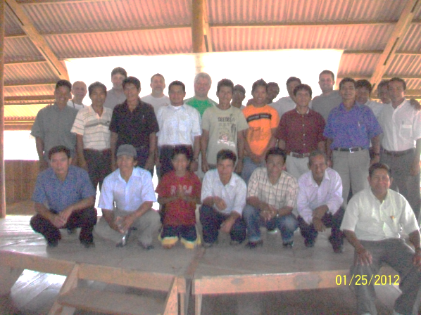
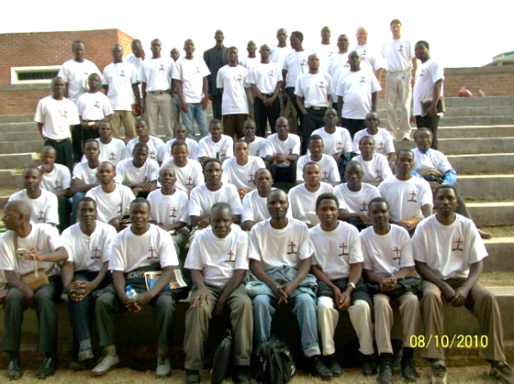
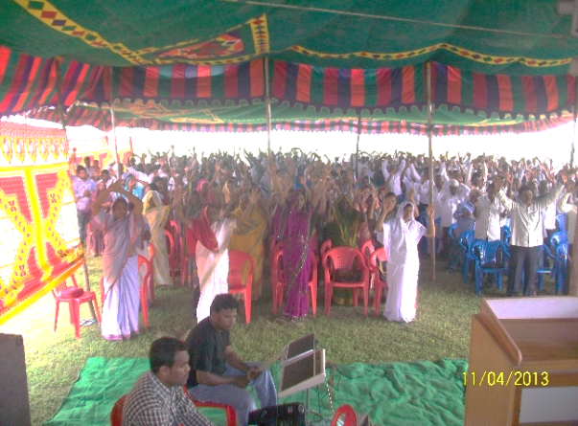
Remote Regions of the Gospel
The remote Amazon jungle Pastors Conference in Pakistan
Pastors Conference in Egypt Pastors Conference in the Amazon
Pastors Conference in Malawi Africa Pastors Conference in India
114

Slide 124
Church Size Pastors Objectives
The pastor needs to spend time with his
congregation. Develop a discipleship program
and teach. Eat together, pray together and
invite others to your church. Focus on building
strong biblical relationships! Train your
congregation. Remember, Jesus started with
12 disciples.
15 – 80
81 – 150
400+
Churches of different sizes will require different leadership skills!
Relationship Skills
Managing Skills
Leadership Skills
As the church grows the pastor can receive
a salary which will free him to spend more time
developing the church. Develop a worship team,
and other key ministries. The church is large
enough to have a fully functional Sunday morning
service. The church is also large enough to
have children’s church. The pastor should be
able to delegate ministry roles to other trained
leaders in his church.
As the church continues to grow the pastor should
hire capable staff to help with the administration of
multiple ministries. The pastor leads leaders at
this size. This size of church will typically have
multiple ministries:
1. Men’s Ministry
2. Women’s Ministry
3. Children’s Ministry
4. Sunday Morning Service
5. Sunday Evening Bible Training
6. Evangelism Ministries
7. Wednesday Evening Prayer
8. Youth Ministry
115

Slide 125
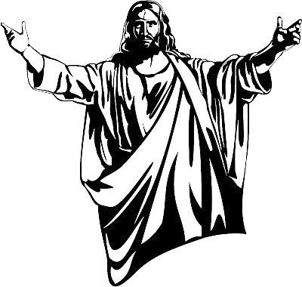
Chapter Seven:
The 7 Churches Jesus Inspected
Jesus was seen by the apostle John walking among the lampstands in heaven.
Each of the lampstands represented a church. As Jesus walked in the midst of these
churches, he inspected them and gave both positive feedback and correction.
As a pastor I am very interested in what Jesus had to say about these churches!
His observations and feedback about these 7 churches helps me understand what
he values as important in the life of a local church. Jesus cares for his church!
While I was serving in the United States Navy, our division would periodically be
inspected by the commanding officer. We would spend weeks in preparation for his
inspection. Everyone was concerned about his visit to our department. In the
same way, Jesus inspects local churches. He inspects churches and holds pastors
accountable for what he finds. Take a moment to study his remarks about these
7 churches. Ask yourself if your congregation is similar to any of the 7 churches?
___________________________
31. Revelation 1:12-20
31
116

Slide 126
Church | Problems | Positive
Ephesians (Apoc.2:1-7) | Left 1st love- grew cold to the Lord while serving. Replaced the Lord with service. | Hard work, perseverance faithfulness, did not tolerate wickedness.
Smyrna (Apoc. 2:8) | Fear of persecution and suffering | Endurance through persecution, slander and poverty
Pergamos (Apoc. 2:12) | False Doctrine allowed sexual immorality, idolatry | Did not renounce their faith
Thyatira (Apoc. 2:18) | False Prophets allowed to influence the church. Sexual sin. | Perseverance, faith and love. Doing more than they did in the beginning!
Sardis (Apoc. 3:1-6) | Reputation of being alive but are dead. Spiritually asleep! | A few members did not compromise and were awake.
Philadelphia (Apoc. 3:7) | Little strength | Stayed true to the Word An open door was before them.
Laodicea (Apoc.3:14) | Lukewarm, indifferent but enjoying prosperity. They were spiritually poor and blind. | No positives mentioned
Each church faced different challenges. No two churches were the same. Jesus
took time to inspect each church. His comments are powerful! He was concerned
about bad doctrine, sexual sin, idolatry, false prophets, lukewarm hearts, spiritual
slumber, fear and little strength.
117

Slide 127
Church | Problems | Pastors Actions
Ephesians 2:1 | Left 1st love- grown cold to the Lord while serving. Replaced the Lord with service. | Call to prayer and fasting. Invite a revival speaker to preach. Preach about intimacy with Jesus.
Smyrna 2:8 | Fear of persecution and suffering | Preach on fear. Spiritual warfare prayers to break fear off of people. Preach on faith!
Pergamos 2:12 | False Doctrine allowed sexual immorality, idolatry | Church discipline for sexual sin. Teach sound doctrine. Repent.
Thyatira 2:18 | False Prophets allowed to influence the church. Sexual sin. | Don’t allow false prophets to stay in leadership. Repent for sexual sin.
Sardis 3:1 | Reputation of being alive but are dead. Spiritually asleep! | Strong preaching and teaching. Personal counseling and prayer.
Philadelphia 3:7 | Little strength | Encourage and strengthen the congregation.
Laodicea 3:14 | Lukewarm, indifferent but enjoying prosperity. They were spiritually poor and blind. | Repent. Identify the true spiritual condition of the church. Strong preaching.
Each one of the problems listed for these churches needed the attention of the
pastor. The pastor is responsible to lovingly guide the church into fruitfulness. The
pastor can use many ministry tools to help correct these problems. A pastor can use
counseling, prayer, mentoring, preaching, teaching and guest speakers to help
strengthen the church.
118

Slide 128
Monitoring Church Life
“Be sure you know the condition of your flocks, give careful attention to your herds” Proverbs 27:23
What is the condition of your church? The Bible exhorts pastors to know the condition
of our flocks and to give careful attention to the herd. Here are some areas to monitor:
Attendance Trends- Have you lost people recently? Where are they?
Church Unity- Is the church walking in unity or is it complaining and grumbling?
Volunteer Service- Are members excited about serving? Or are they quitting?
Prayer- Is the church active in prayer? Do people have expectancy?
Church Talk- What are people talking about? Do they Gossip? About what?
Anointing- Are your services anointed with the presence of Jesus?
Discipleship- Are people growing in discipleship through the Word?
Reputation- What is your reputation in the community?
Outreach- Are people excited about sharing their faith?
Sound Doctrine- Does the church hold to sound doctrine?
Personal Purity- Are members walking in holiness or compromise with sin?
119

Slide 129
Conclusion
I admit that ministry can be overwhelming at times. I also confess that I have felt
like quitting many times. When I go through difficult times in ministry, I remember my
calling. I remember then I am called to be obedient. I recognize that the Lord expects me
to be a faithful shepherd. Most of all I want to please him! I want him to say, “well done
good and faithful servant”!
I also think about some of the joys of ministry when I feel discouraged.
The joy of representing the Lord to others
The joy of being intimately acquainted with people
The joy of pleasing the Lord
The joy of future rewards
The joy of changed lives
The joy of awesome friends in ministry
The joy of partnering with the Holy Spirit
The joy of doing something of eternal value
The joy of his anointing for ministry
The joy of witnessing miracles
One day the Lord will ask every pastor what they did with His Church! My hope is
that you will hear these words spoken by Jesus, “Well done good and faithful servant”!
But you should keep a clear mind in every situation. Don't be afraid of suffering for the Lord. Work at telling others the Good News, and
fully carry out the ministry God has given you.
120

Slide 130
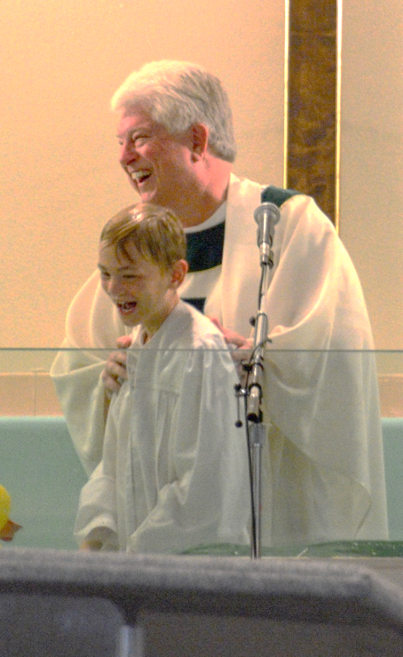
You can contact Dr. Bill at pastorbreon@yahoo.com
or on Facebook at Bill Breon

Slide 131
BIBLIOGRAPHY
Strong, James LL.D., S,T,D, The New Strong’s Exhaustive Concordance of the Bible,
Nashville: Thomas Nelson Publishers, 1995
Today’s Parallel Bible: NIV, Updated NASB, KJV, NLT. Michigan: The Zondervan Corporation, 2000
ADDITIONAL RESOURCES
Bisagno, John, Pastor’s Handbook, Nashville: B&H Publishing Group, 2011
The Christian Handbook for Pastors, Minneapolis: Augsburg Fortress, 2006
The Pastor’s Handbook, Camp Hill: Wing Spread Publishers, 2001
Hutton, Samuel, Minister's Service Manual, Grand Rapids: Baker Books, 2003
Hansen, David, The Power of Loving Your Church, Minneapolis: Bethany House Publishers, 1998
Hutton, Samuel, Minister’s Marriage Manuel, Grand Rapids: Baker Book House, 1968
Preston, Gary, Character Forged in Conflict, Minneapolis: Bethany House Publishers, 1999
Smith, Fred, Leading With Integrity, Minneapolis: Bethany House Publishers, 1999
Cadenhead, Al, The Minister’s Manual for Funerals, Nashville: Broadman & Holman Publishers, 1988
Barrier, Roger, Listening to the Voice of God, Minneapolis: Bethany House Publishers, 1998
121

